Slide 1





GMV6 Multi VRF Unit
Gree Electric Appliances, Inc. of Zhuhai

Slide 2
01
Product Introduction
CONTENTS
02
Typical Features
03
Compare to Competitive Products

Slide 3
Product Introduction
Part 1
Product introduction
Selling points

Slide 4
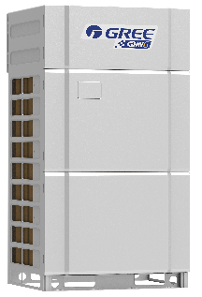
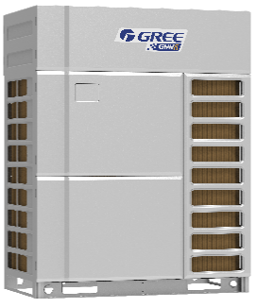
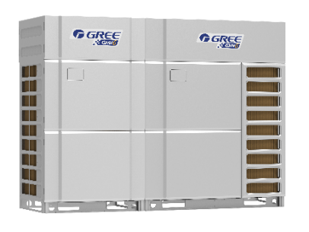
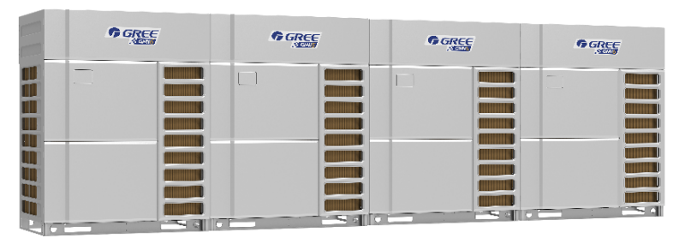
Overview
Product introduction
Capacity HP | 8, 10, 12 | 14, 16, 18 | 20, 22, 24 | 26 | …… | 96
Model | GMV-224WM/G-X GMV-280WM/G-X GMV-335WM/G-X | GMV-400WM/G-X GMV-450WM/G-X GMV-504WM/G-X | GMV-560WM/G-X GMV-615WM/G-X GMV-680WM/G-X | GMV-335WM/G-X + GMV-400WM/G-X | …… | GMV-680WM/G-X*4
External look |  |  |  |  | ……
Core features | Excellent performance |  |  | Stable, reliable |  | Adaptable, flexible
 | ① High-efficiency low-temp enthalpy-adding technology ② New type heat exchanger design ③ Intelligent control ④ Strong cooling/heating technology ⑤ Noise control technology |  |  | ① CAN+ communication technology ② Self-adapting drive control technology ③ Oil quality control technology ④ Oil circuit management technology ⑤ Compact structure ⑥ Super wide operating range |  | ① Large capacity, compact design ② Super high static pressure ③ Long connection pipe, large drop difference ④ Quick installation design ⑤ High degree of installation adaptability
Operating range | Cooling：-5℃~52℃ Heating：-30℃~24℃

Slide 5
Overview
Core selling points——Asia Pacific
Efficient enthalpy-adding and heat exchange
New type compressor
6 strong noise control technologies
Large-flow and low-noise air duct
Sound absorption, sound insulation
Enthalpy-adding pulse control
Low-noise intelligent commutation
Refrigerant flow noise reduction
Intelligent quiet control
Intelligent control and management
Distributed remote central control system
Large capacity, compact design
Connectable to 100 IDUs
Wide capacity range
Compact design
Multiple gateway protocols (modbus\KNS\BACNET\modbus mini)
Intelligent billing calculation system
Dual EEV enthalpy-adding control
Multiple EEV flow control technology
High-efficiency heat exchanger
Layered dual-zone heat exchange
Large flow air duct
Operating range: -30℃-52℃
GMV6
4 cores

Slide 6
Product Features
Part 2
Excellent performance
Flexible engineering design
Stable, reliable
Convenient installation

Slide 7
Excellent performance
1
2
3
4
Efficient and powerful
Efficient heat exchange
Intelligent and efficient control
Noise control
New type compressor;
Dual EEV enthalpy-adding control;
Multi EXV technology;
New generation intelligent defrosting technology;
Powerful low-temp heating
High-efficiency heat exchanger;
Layered dual-zone heat exchange;
Low-noise large-flow fan
Double energy-saving modes;
HPAC efficient modular control;
SRL load self-adapting control;
Intelligent refrigerant circuit control;
Intelligent low-power control
Low-noise air duct;
Sound absorption, sound insulation;
Enthalpy-adding pulse control;
Low-noise intelligent commutation;
Refrigerant flow noise reduction;
Intelligent quiet control

Slide 8
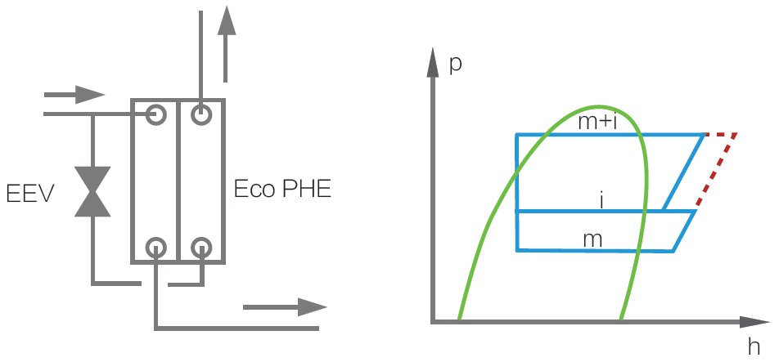
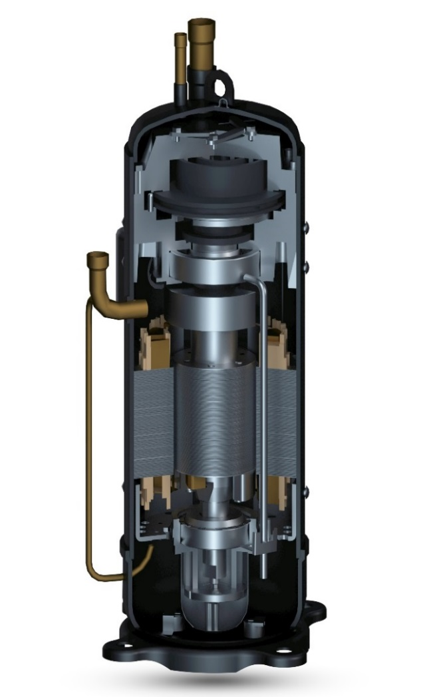
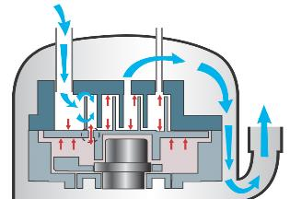
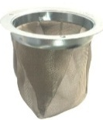
Excellent performance
Features
①Efficient low-temp enthalpy-adding system——New type compressor
Specially designed for VRF units, it can improve cooling capacity by 10% and low-temp heating capacity by 30%.
1 Enhanced vapor injection(EVI)
Improve system capacity, expand operating range, increase heating speed
2 Pressure relief valve
Improve partial load efficiency, adapt to
transformer ratio, improve product performance
1
Air suction
Hi. pressure
Vapor injection
Structure of relief valve
Low pressure
2
Discharge pressure
Relief valve
Air discharge
Open valve
Mid pressure
3
Compr. pressure
Fixed
Compressor cavity pressure＞discharge pressure
3 Optimized asymmetric vortex line
New asymmetric vortex line to reduce leakage loss,
reduce inhalation and overheating.
It is more suitable for APF conditions and improves
system efficiency.
4 Internal oil circulation
Internal oil circulation to reduce heat loss,
reduce fuel injection rate, improve efficiency
and reliability.
4
5
6
6 High speed
0~140rps variable speed,
a wide range of capabilities
5 Dynamic oil balance
Patented oil balance technology, highly reliable,
flexible, no installation restrictions. It can be used
in parallel with compressors of different displacement
and speed.
8
8 Volumetric gear pump
Ensure necessary oil supply at variable speed
and improve compressor reliability.
7 Oil pump filter
Filter impurities to ensure clean oil supply.
7

Slide 9
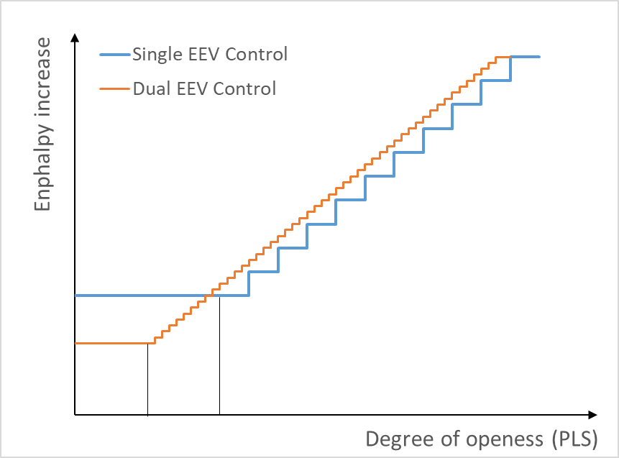
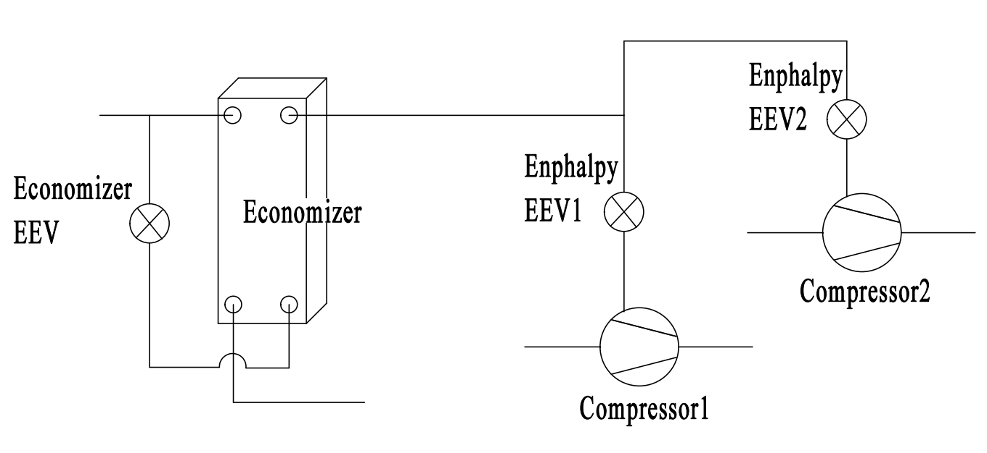
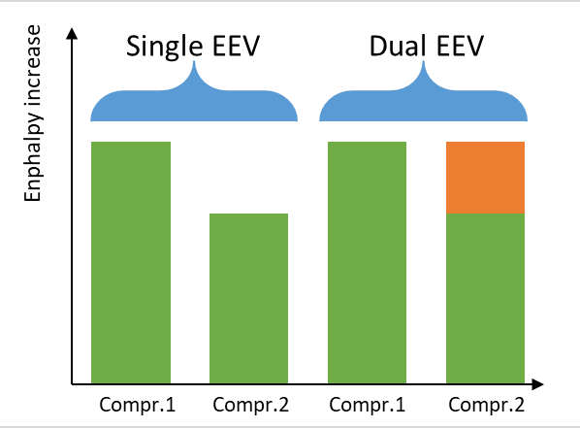
Excellent performance
Features
①Efficient low-temp enthalpy-adding system——Dual EEV enthalpy-adding control
2400-step precise adjustment, wider adjustment range, more stable;
Dual-compressor system to flexibly adjust the amount of enthalpy increase between compressors, to maximize enthalpy increase;
Plate type economizer, higher heat exchange efficiency

Slide 10
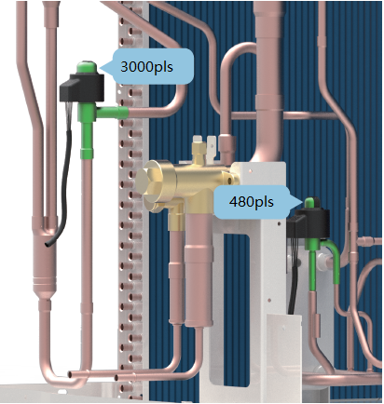
Features
Excellent performance
① Efficient low-temp enthalpy-adding system——Multiple EEV flow control
Multi EXV control technology
EXV is one of the 4 basic parts of the air conditioner. It is not only a throttle but also a device to adjust the flow rate of refrigerant entering the evaporator. The wider the adjustment range, the higher the accuracy.
ODU adopts dual EXV control. The main EXV is a 3000-step EXV whilst the sub-cooling EXV is a 480-step EXV. They can precisely control the flow between IDU and ODU.
IDU adopts silent type EXV control. It can precisely control the flow of refrigerant. The adjustment is smooth and stable, improving comfort and system reliability.

Slide 11
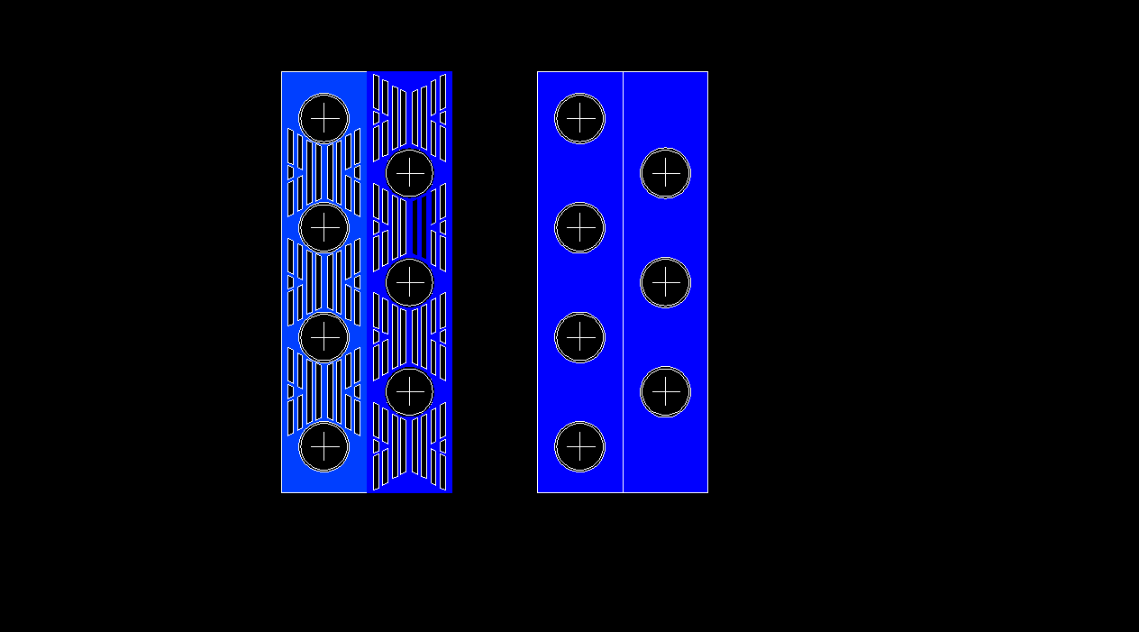
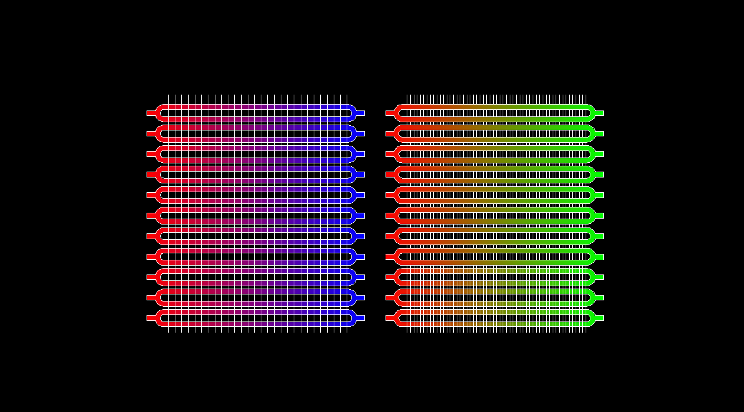
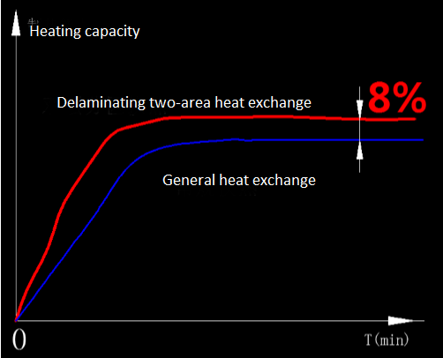
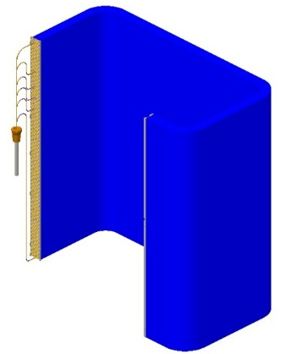
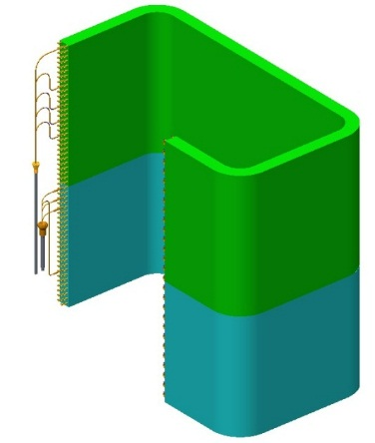
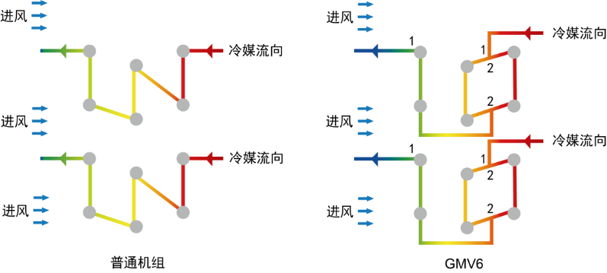
Features
Excellent performance
②Efficient heat exchange——Efficient heat exchanger
Corrugated small pitch heat exchange fins
The overall heat exchange efficiency is higher;
Less fin section, stronger corrosion resistance;
Corrugated hydrophilic design, easier defrosting;
Others
GMV6
Others
GMV6
②Efficient heat exchange——Layered dual-zone heat exchange
According to the characteristics of the wind field, the heat exchanger is divided into different zones. The upper and lower levels adopt different capillary tubes. With the 1-2-2-1flow path design, the efficiency is higher. Heat exchange rate is up by 8%.
Air flow
Air flow
Refrigerant flow
Refrigerant flow
Air flow
Air flow
Refrigerant flow
Refrigerant flow
Air flow
Air flow
GMV5
GMV6
GMV5
GMV6

Slide 12
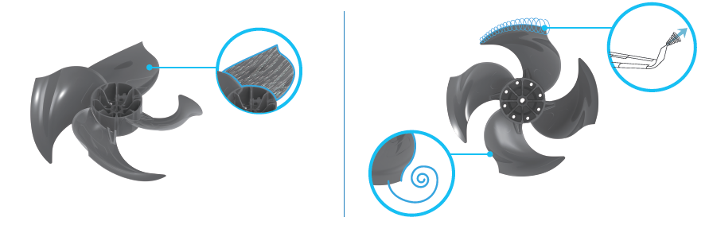
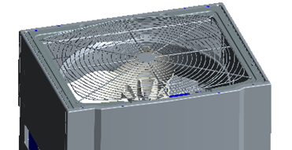
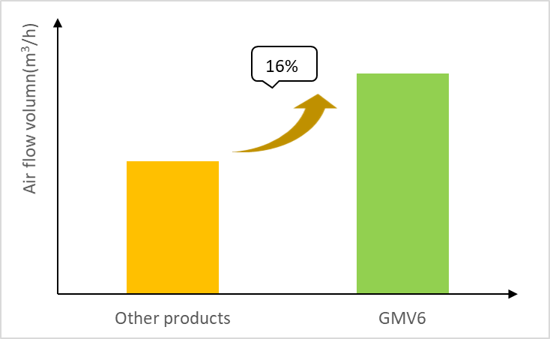
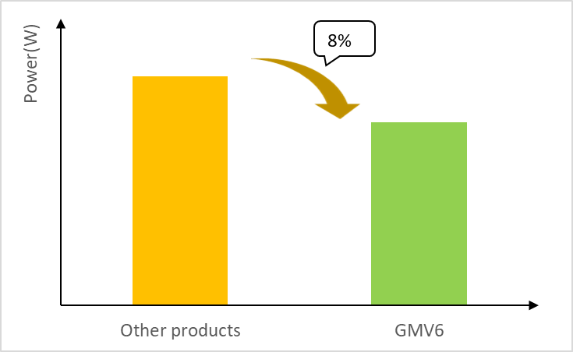
产品特点
Excellent performance
Features
②Efficient heat exchange——Large flow air duct
Optimized fan blade design to increase blade forward curve, suppress eddy current and reduce leakage.
The reversed S-shaped tail design effectively increases the work area of the blades and greatly increases the air volume.
New type air grille, with air output area up by 7.8%
Compared to other conventional units, the air volume of GMV6 is up by 16%.

Slide 13
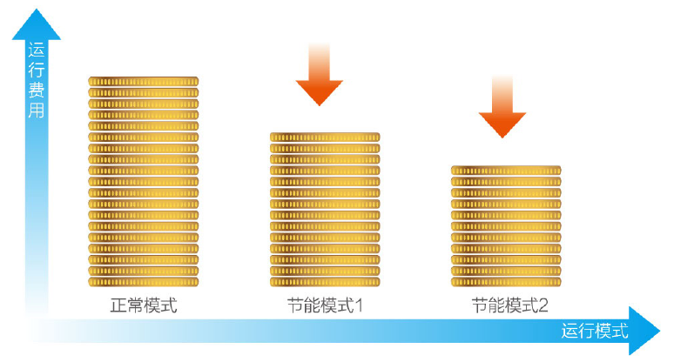
Excellent performance
Features
③Intelligent efficient control——Double energy-saving modes
GMV6 offer a variety of operating modes for users to meet the requirements for power supply in peak time.
Capacity first: If there is sufficient power supply, priority is given to meeting the capacity needs. This mode is default factory setting.
Auto energy-saving: System will automatically adjust parameters and balance the capacity and energy consumption according to the running state.
Forcible energy-saving: Capacity output of ODU is limited. Depending on power consumption and user needs, a 90% or 80% capacity ratio can be selected.
Operation cost
MAX15%
MAX20%
Note: When the above energy-saving modes are set, cooling capacity and heating capacity will decrease by 10%~20%.
Capacity first
Auto energy-saving
Forcible energy-saving
Running mode

Slide 14

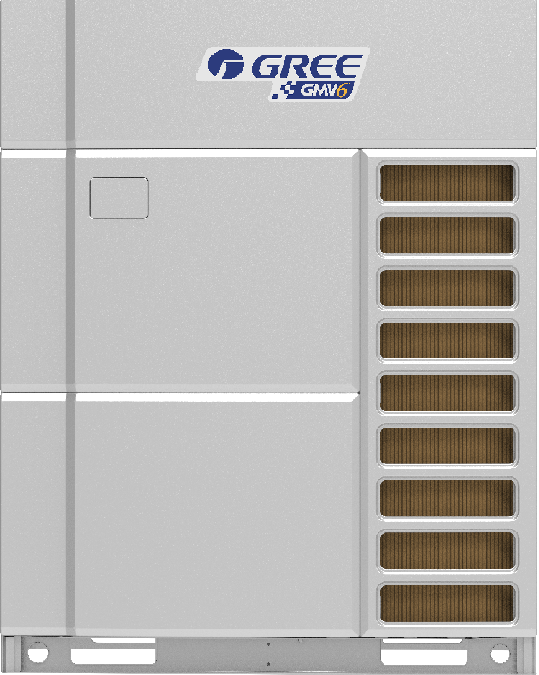
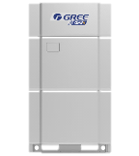
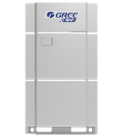

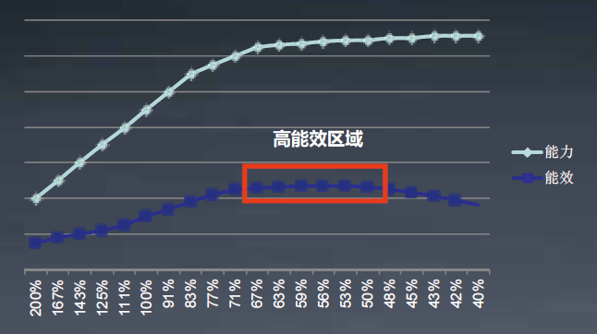
Excellent performance
Features
③Efficient intelligent control——HPAC efficient modular control
GMV6 adopts HPAC new modular control to adjust the distribution method according to the indoor load demand, to ensure maximum energy efficiency.
Compr.
IDU heat exchanger
ODU heat exchanger
Conventional control
GMV6-HPAC control
There is optimum matching between the compressor, indoor heat exchanger and outdoor heat exchanger. The indoor and outdoor heat exchanger capacity are automatically matched and adjusted in real time according to system operating conditions.
Excellent efficient region
Capacity
Efficience
HPAC: high performance alternate control.

Slide 15
Excellent performance
Features
③Intelligent efficient control——SRL load self-adapting control
SRL(Self-Reaction Load): intelligently detect and control refrigerant pressure and temperature according to user status and indoor temperature changes, automatically adapt to indoor cooling and heating load and achieve energy-saving balance control.
Cooling mode
Heating mode
General power change
General power change
SRL power change
SRL power change
SRL low pressure change
General high pressure change
SRL high pressure change
General low pressure change
Expected indoor temperature
Actual indoor temperature
Expected indoor temperature
Actual indoor temperature
With the above comprehensive control, energy efficiency can be increased by up to 20%

Slide 16
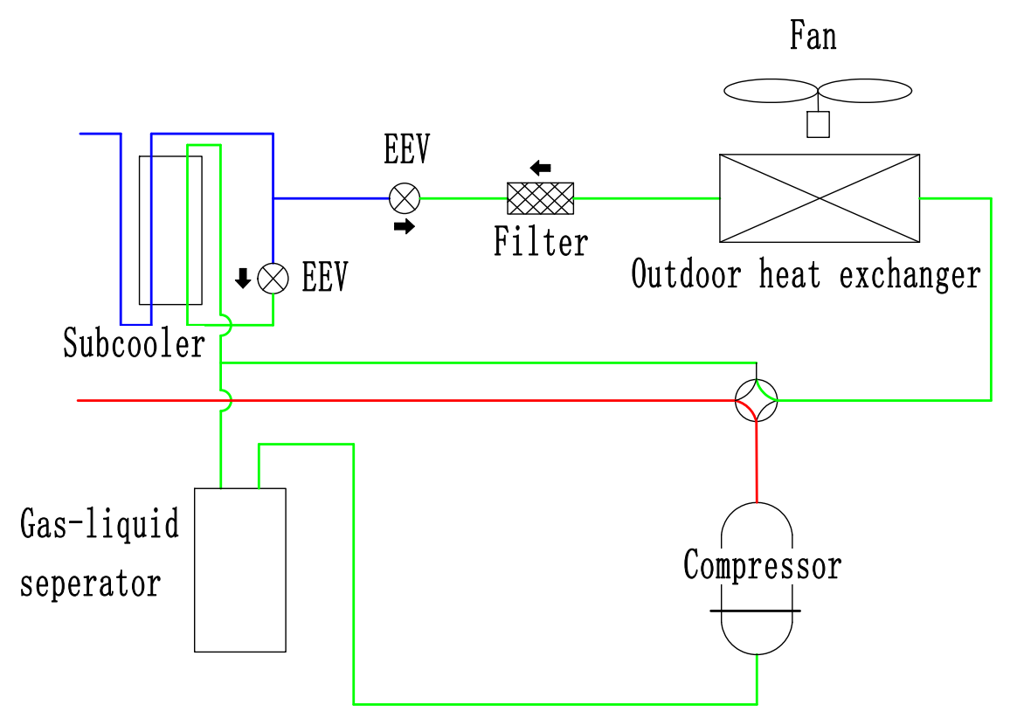
Features
Excellent performance
③Intelligent efficient control——Intelligent refrigerant circuit control
Low-temp refrigerant transfer technology
Intelligently judge whether the amount of refrigerant circulation is sufficient according to system parameters (pressure, temperature, speed, etc.). Refrigerant transfer is performed automatically and heating capacity is improved by 15%.
15%
Judge in operation
Pressure control
Large heat exchange temperature difference control
Low-temp liquid refrigerant
Low-temp liquid refrigerant
Heating capacity

Slide 17


Features
Excellent performance
③Intelligent efficient control——Intelligent low-power control
Standby sleep technology
Ordinary mode
Sleep mode
By cutting off the power supply of the function module and reducing the communication frequency, the unit can stay in standby mode with low power consumption.
Comm.
Main control power consumption
Drive power consumption
Comparison of state before and after low-power control of different modules
Time（min）
Standby power consumption of VRF ODU
ON-28W
ON-8W
  POWER OFF
DEEP SLEEP
Standby sleep mode
E-heating
Drive
E-heating
Drive
Power control
≈≤3W
≈40W
ON-2W
ON-2W
SLEEP
SLEEP
Main control
Comm.
Main control
Sleep mode
Comm. module

Slide 18



Features
Excellent performance
④Strong cooling and heating technology——New generation intelligent defrosting
Advancement of defrosting technology
Time defrosting
Sense temperature/ pressure to defrost
Intelligent defrosting
Old units
Common units
GMV6
Defrost at a preset time, regardless of frost.
Defrost according to tube temperature and system pressure.
Variable period, variable defrosting capacity
Defrosting and heat storage module
Work load rate
Sys. temp & pres.
Continuous heating time up by 40%.
Defrosting time reduced by 30% at most.
-18-

Slide 19
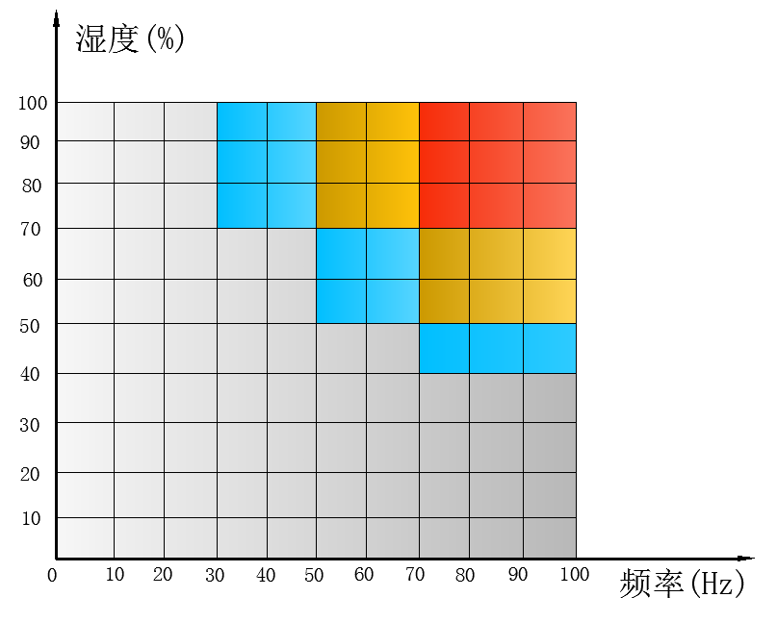
Excellent performance
Features
④Strong cooling and heating technology——New generation intelligent defrosting
●Engineering self-adapting control
1）Variable load rate control
With different load requirements, the output capacity of ODU varies accordingly, and the frosting degree of outdoor heat exchanger is also different.
To determine frosting degree and different defrosting temperature according to different load and heat exchange temperature difference. W=f(x, t, ∆T)
X = load rate，t = running time，
∆T = heat exchange temperature difference
Humidity(%)
2）Variable defrosting period control
Frosting degree is determined based on the change of defrosting time in different environments. The unit will automatically adjust the defrosting period to increase the accuracy of defrosting demand.
Frequency(Hz)

Slide 20
Excellent performance
Features
④Strong cooling and heating technology——New generation intelligent defrosting
●Engineering self-adapting control
3）Variable defrosting capacity
Defrosting speed is closely related to compressor output. In general, the unit will limit the output capacity of compressor during defrosting, which would lead to long defrosting time or abnormal defrosting.
GMV6 can automatically change the output capacity during defrosting by real-time parameter learning and judgment, so as to achieve stable or fast defrosting.
System pressure
Compressor temperature
Defrosting capacity
Defrosting time
MAX20%
Defrosting capacity after adjustment
MAX20%
Original defrosting capacity
Original defrosting time
Defrosting time after adjustment

Slide 21
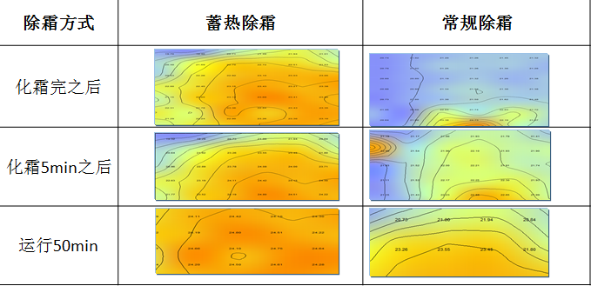
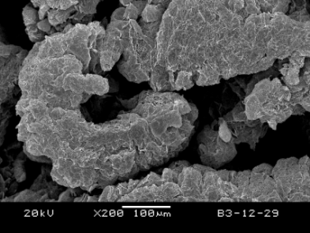
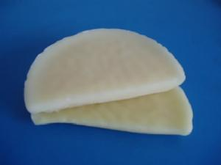
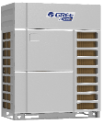


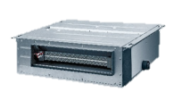
Excellent performance
Features
④Strong cooling and heating technology——New generation intelligent defrosting
●Heat storage and defrosting (optional)
GMV6 can use the heat storage module. Through the heat exchange between the ODU and the heat storage module, it can realize rapid defrosting, reduce room temperature fluctuation and quickly restore efficient operation after defrosting.
High energy storage high efficiency phase change material——Paraffin and expanded graphite composite
Paraffin has a large latent heat of phase change, and the mass fraction of paraffin in the composite material is 90%. The latent heat of phase change can reach 161.2J/g. The heat storage time and exothermic time of the composite were shortened by 27.4% and 56.4%, compared to pure paraffin.
Heat storage defrosting is faster than general defrosting
15%
高1~2℃
高2~3℃
高1~2℃
Expanded graphite
Paraffin
Heat storage defrosting
General defrosting
Heat storage defrosting mode
General defrosting mode
Heat storage defrosting time VS general defrosting time
*Test conditions: initial indoor working condition: 5℃，outdoor side: 0℃/95%, free temperature rise test，XY plane，Z=1.0m
Heat storage module
蓄热模块

Slide 22
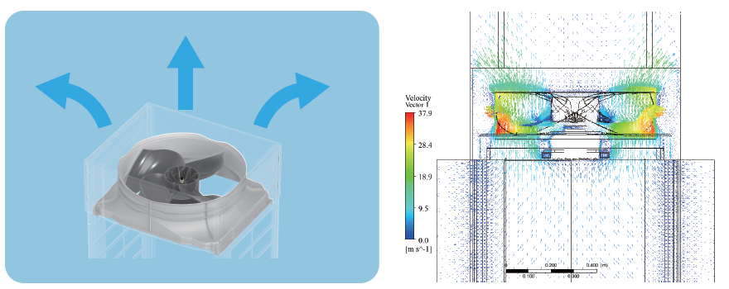
产品特点
Excellent performance
Features
⑤Noise control technology——Large-flow and low-noise air duct
Large air volume and low noise fan: The reversed S-shaped tail design effectively increases the work area of the blades and greatly increases the air volume. Tail of the blade is designed from the winglet of the aircraft, which can effectively suppress the tip vortex generated by the wing tip pressure difference and reduce noise.
Immersed layout for the air duct: The whole air duct system is sunk and the whole structure is an immersed structure, which can effectively reduce wind noise and improve the convenience of transportation.

Slide 23
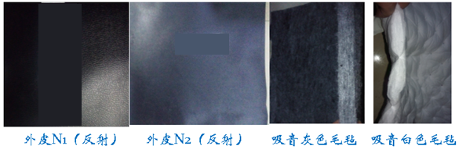
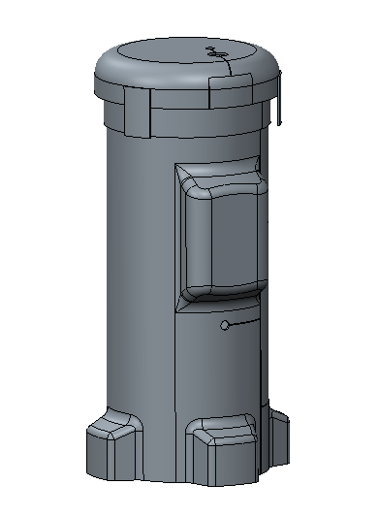
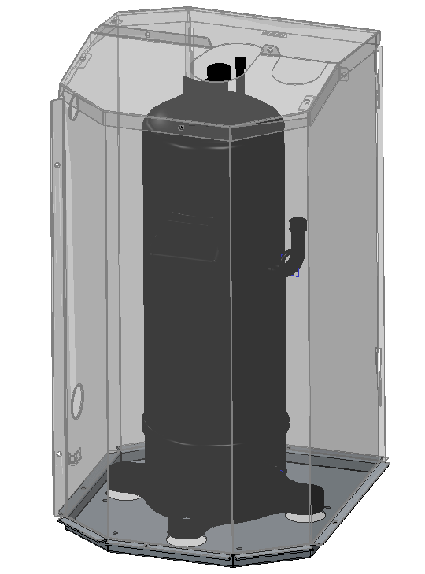
Excellent performance
Features
⑤ Noise control technology——Sound absorption, sound insulation
Sound absorber: After several times of onsite noise data acquisition and data calculation, we use the new sound absorption material. The structure is an integrated structure and cooperates well with the compressor.
5dB(A)
Integrated type sound absorber
Metal sound-proof enclosure
Surface N1 (Reflection)
Surface N2 (Reflection)
Absorption material (Gray)
Absorption material (White)
Metal sound-proof enclosure: It consists of a sheet metal layer and a sound absorbing layer. It is soundproof, waterproof and anti-aging. The sound absorbing layer is adhered to the inner wall of the sheet metal layer. It is a new sound absorbing material that can effectively absorb sound and vibration.

Slide 24
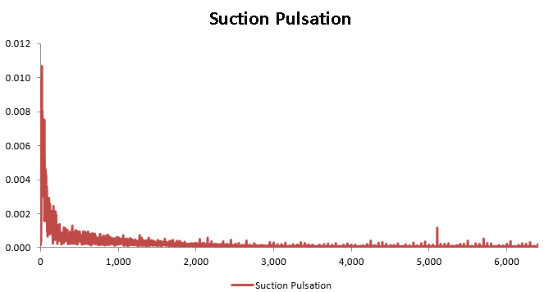
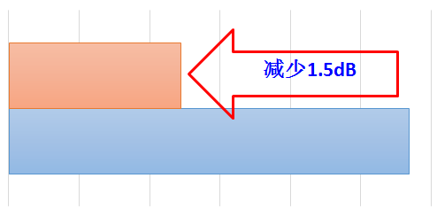
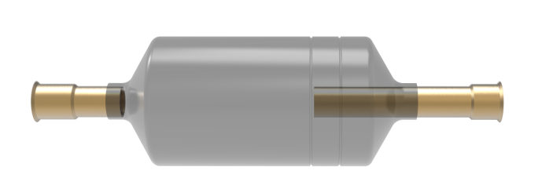
产品点
Excellent performance
Features
⑤ Noise control technology——Enthalpy-adding pulse control
According to the sound intensity cloud and the pulsation characteristics of the unit, we develop the enthalpy-adding pulse buffer silencer, which can reduce noise by 1.5dB.
New type silencer
Down by 1.5dB
Due to the intermediate air replenishment, a reverse pulse is formed on EVI pipeline after high-speed rotation.
Common silencer
New type silencer

Slide 25
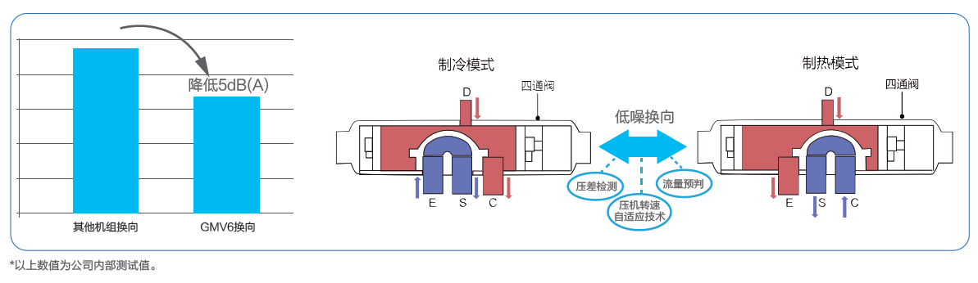
Excellent performance
Features
⑤ Noise control technology——Low-noise intelligent commutation
The 4-way valve adopts low-freq. commutation design. Through differential pressure detection and flow prediction, compressor speed is self-adjusted during commutation. Refrigerant flow pulse is small and commutation noise is effectively reduced. The valve is thus more reliable.
Cooling mode
Heating mode
Down by 5dB(A)
4-way valve
4-way valve
Low-noise commutation
Differential pressure detection
Flow prediction
Commutation of other units
Commutation of GMV6
Compressor speed self-adapting technology
The above value is the company’s internal test value.

Slide 26
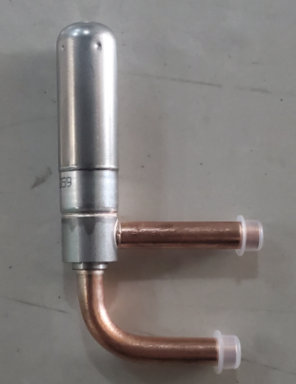
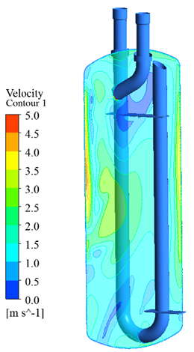
Excellent performance
Features
⑤ Noise control technology——Refrigerant flow noise reduction
GMV6 uses three major refrigerant flow noise reduction technologies for further improving user experience.
●Refrigerant status control
According to the mechanism of refrigerant flow noise, we adopt efficient sub-cooling and overheating technology to effectively prevent the two-phase refrigerant from generating throttling noise and eddy current noise.
Two-phase gas and liquid refrigerant
General control
Single-phase liquid refrigerant
Special control
●Use silent throttle unit
The indoor unit adopts a specially-designed silent throttle unit and a silent expansion valve, which can satisfy step-down flow distribution and reduce throttling noise to the max.
●Use silent gas separator
This is a specialized low-noise large-volume gas liquid separator. The shape and angle of the inlet and outlet pipes are specially designed for variable load conditions. It can effectively reduce the impact and airflow noise of gas and liquid separation.

Slide 27
Excellent performance
Features
⑤ Noise control technology——Intelligent quiet control
It can learn, define and remember user habits.
Define user habits | User startup repetition rate | User startup quantity rate
Habit 1 | ≥90% | User startup quantity rate for a days ≥X%
Habit 2 | ≥90% | X>User startup quantity rate for b days ≥Y
…… | …… | ……
It can automatically determine the output capacity of the system in the next 24 hours to achieve auto quiet operation.
Learning and defining
Intelligent quiet operation
Intelligent quiet operation
Status changed, learning again
Down by 3dB(A) at most
Actual load demand W
(depend on outdoor temperature T and difference from indoor temperature ∆T）
Restore normal output
Normal output
Intelligent output adjustment
System capacity output Q

Slide 28
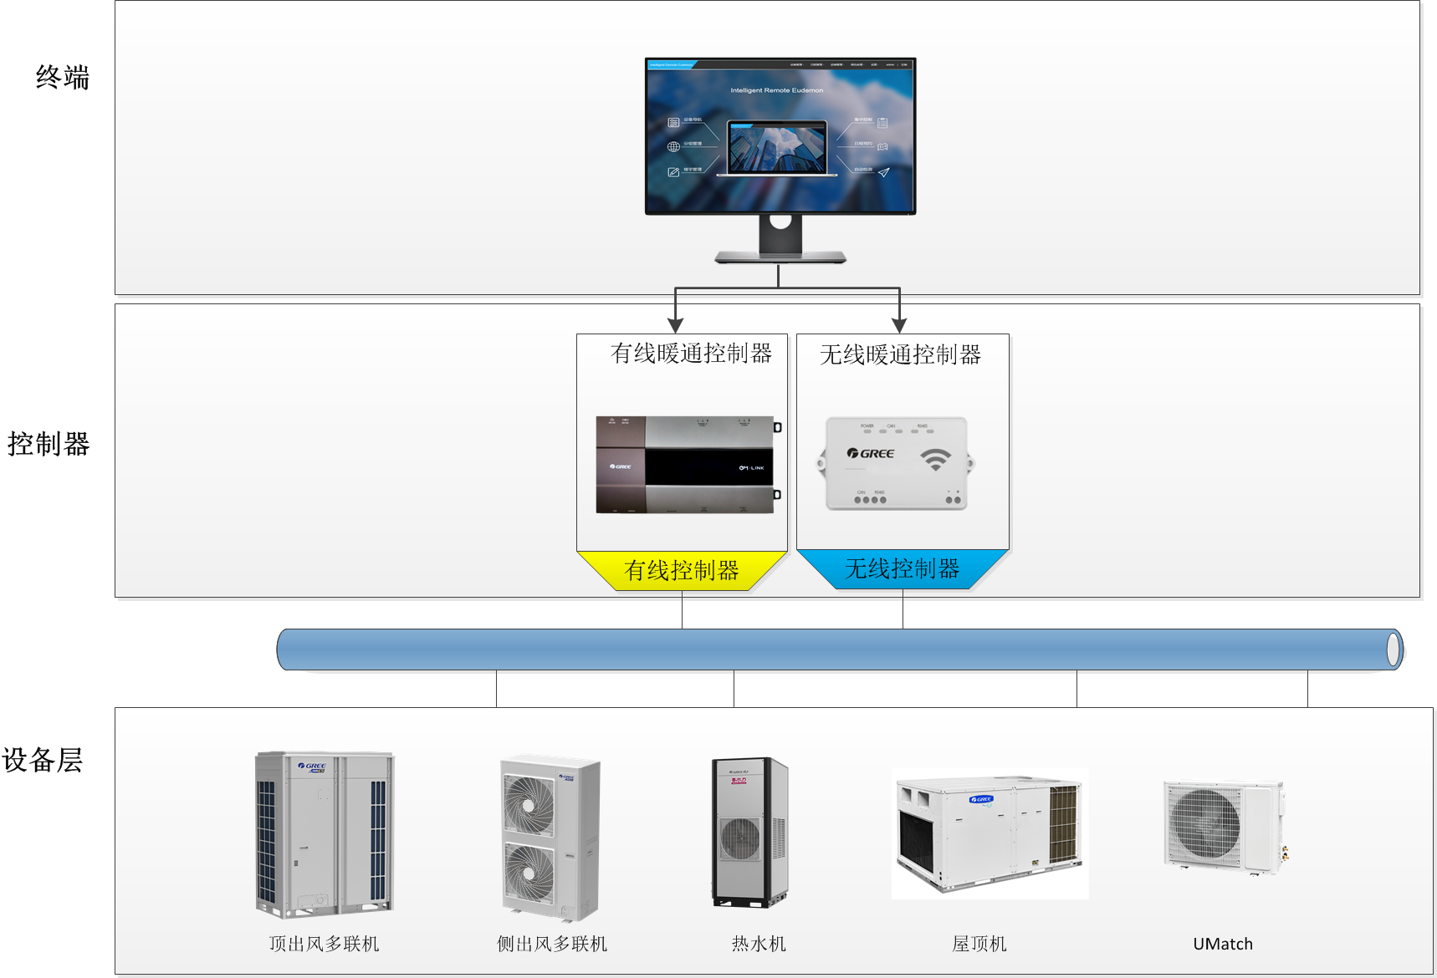
Excellent performance
Features
⑥Intelligent control and management——Provide 24h monitoring program
Remote monitoring solution
Wired solution
Provide wired solutions to solve the monitoring of a large number of centralized air conditioning equipment.
Wired
Wireless
Wireless solution
Provide wireless solutions for fast and agile monitoring, suitable for difficult wiring situations, and for distributed monitoring.

Slide 29
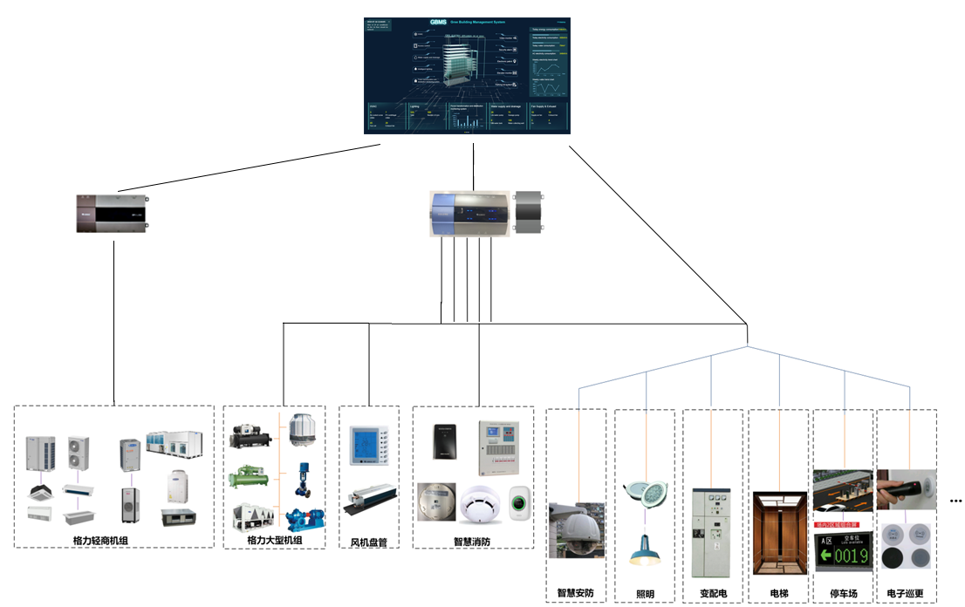
Excellent performance
Features
⑥Intelligent control and management——G-BMS Gree Building Management System
Access to G-BMS Gree Building Management System
G-BMS Building Management System
Light commercial air conditioner remote monitoring system can be connected to G-BMS Gree building management system to achieve building level monitoring and management

Slide 30
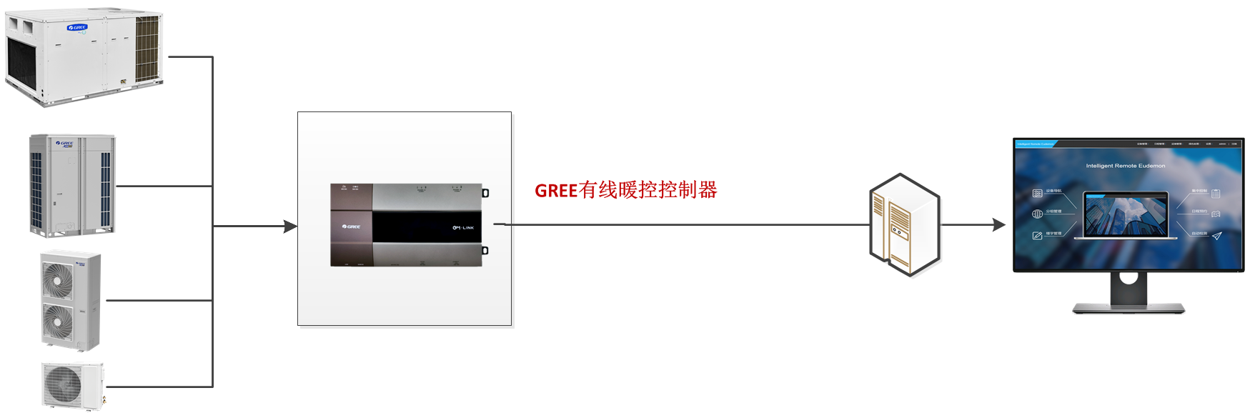
Excellent performance
Features
⑥Intelligent control and management——Gree remote monitoring system
Gree remote monitoring system
Gree remote monitoring system provides wired monitoring solution for centralized management and monitoring of HVAC equipment;
This solution meets the air conditioning monitoring needs in multiple scenarios and facilitates property management.
Large-scale group control
The system can access 8160 internal machines
Responsive
Achieve second level control
Distributed networking
Distributed networking, meeting LAN and WAN
GBM-LCG100E
FE30-24/DF(B)
Multi-model support
Support multi-line, roof machine, u-match, hot water machine, large air duct

Slide 31
Excellent performance
Features
⑥Intelligent control and management——Multiple protocol gateways
Protocol gateway
Provide multiple protocol gateways
Multi-model support
product type | product | model
BACnet gateway | BACnet Gateway（multi-line） | ME30-24/D4(B)
 | BACnet Gateway（U-Match、roof machine） | ME30-44/D1(B)
Modbus gateway | H2M Gateway | ME31-33/EH1(M)
 | Modbus Gateway（TCP） | ME30-24/E5(M)
 | Modbus Gateway（RTU） | ME30-24/E6(M)
KNX gateway | S2S KNX Gateway | ME30-24/F1(K)
Support multi-line, roof machine, umatch, hot water machine, large air duct
Multi-machine protocol support
Support Modbus, Bacnet, KNX and other protocols
Third party BMS system docking
Dockable smart home and BMS system
Modbus Gateway TCP
BACnet Gateway
Modbus Gateway RTU
H2M Gateway
S2S KNX Gateway

Slide 32
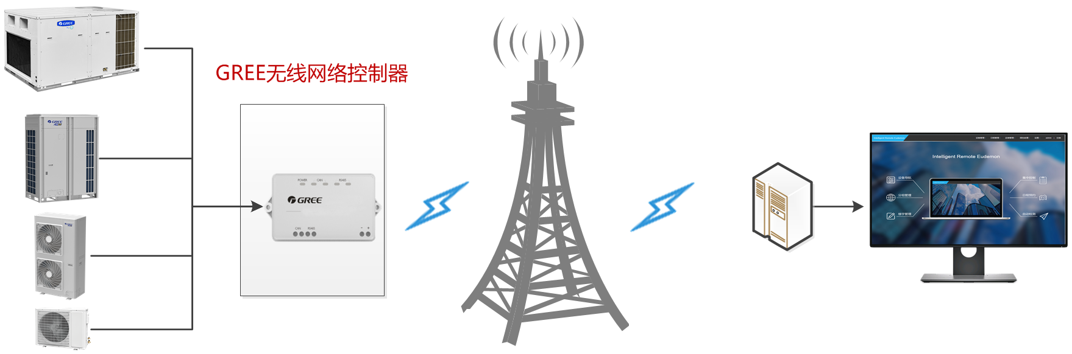
Excellent performance
Features
⑥Intelligent control and management——Flexible and personalized
Gree Wireless Remote Monitoring System
The wireless solution is suitable for the accurate monitoring of HVAC equipment. This solution meets the air conditioning monitoring requirements in special scenarios. The installation is simple, especially suitable for scenes that cannot be wired in a large amount. Wireless monitoring can also be combined with Gree HVAC big data to achieve more convenient service.
Wireless monitoring
Wireless HVAC data acquisition and monitoring via wireless
Agile debugging
No wiring required, installation can be used, and the use of the scene is wide
Distributed management
As long as there is a wireless signal, it can be connected to the system to achieve unified management across the country.
Fault warning
Realize early warning of air conditioning failure and detailed data monitoring
Multi-channel support
Support North America, Israel, Saudi Arabia

Slide 33
Stable, reliable
1
2
3
4
5
Self-adapting drive control
Oil system control
Rotation control
Compact structure
Cooling system high adaptability
Motor winding heating;
Variable heating power control;
Backup heating control;
Low-temp multi oil circuit management;
Differential pressure variable flow oil return;
Self-balancing control without oil balance pipe;
Active compressor oil drain control;
Module piping adaptive control;
Variable load and frequency control;
Strong torque start control;
Flexible enthalpy-adding control with sub-cooling technology;
Variable cycle module rotation;
Compressor rotation;
New generation PCB design;
New electrical components;
Ultra-low temp startup control;
Ultra-low temp running control;
Low-temp anti-freezing control;
Super-wide working temp range;
Super-wide working voltage range;
System refrigerant quantity warning technology;
Advanced liquid strike prevention technology;

Slide 34
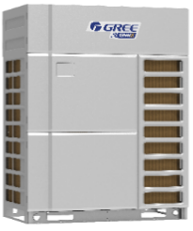
Stable, reliable
Features
①Advanced control platform——CAN+ communication
Thanks to CAN+ technology, the number of IDUs in a single system has changed from 80 to 100, expanding the scope of engineering applications, making the installation and maintenance more convenient.
ID section（arbitration section in CAN protocol） |  |  |  |  |  | Data section（DATA）
11bits |  |  | 18bits |  |  | 8*N bits
4bits | 4bits | 3bits | 4bits | 7bits | 7bits | 8*N bits
Function code |  | CAN2 network addr. |  | CAN1 network addr. | Data type | Data section
Function extensibility: support 256 function types and priority levels |  | The number of devices is expandable: 128*128=16384 devices |  |  | Business data extensible: 128*256=32768 bytes
100 sets

Slide 35
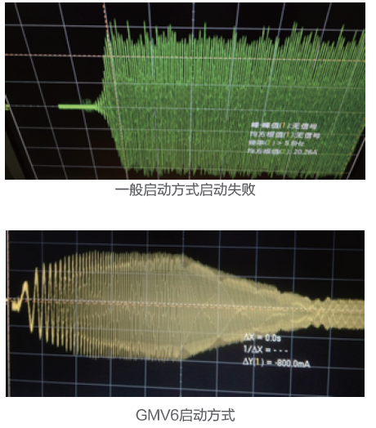
Stable, reliable
Features
②Self-adapting drive control
——Variable load and frequency control
② Self-adapting drive control ——Strong torque start control
Based on the operating characteristics of the compressor, the load frequency is automatically switched to maximize efficiency and reliability.
No need for external balancer. Compressor torque self-feedback and adjustment control are adopted. The compressor can start under high pressure difference, ensuring system continuity and stability.
High freq. operation
Low freq. operation
Startup
Freq. & load change
Freq. & load1
Freq. & load 2
General startup failed
Better dynamic performance
Improve efficiency
Lower noise
Maintain stable control
GMV6 startup

Slide 36
Stable, reliable
Features
②Self-adapting drive control ——Flexible enthalpy-adding control
Generally, system adopts “0←→1”switching mode to switch between the increase and non-increase of enthalpy, which may lead to dramatic load change of the compressor, shutdown or even damage to the compressor.
GMV6 utilizes the linear flow variation features of EEV to gradually increase the load during enthalpy increase, and achieve stable and continuous operation.
Sudden overload
protection
Enthalpy-adding demand
Common solenoid valve control
GMV6 EEV flexible control
Common solenoid valve loading
Stable transition of loading
No enthalpy-adding demand
GMV6 EEV flexible loading

Slide 37



Stable, reliable
Features
②Self-adapting drive control ——Sub-cooling technology
●Sub-cooling technology
The compressor IPM module adopts sub-cooling 360° circular structure to ensure that the internal components work at a lower temperature. Compared with ordinary air-cooled cooling, the internal temperature can be reduced by up to 10℃. The reliability is greatly improved.
●Control algorithm for anti-condensation in high humidity
By detecting the ambient temp, the pressure and temp inside the pipe, IPM temp, etc., the control algorithm for low-temp high-humidity environment is determined to protect the internal components from condensation and damage.
Pipe pressure & temp.
Ambient temp.
Control algorithm
IPM temp.

Slide 38


Stable, reliable
Features
②Self-adapting drive control ——High voltage shock prevention technology
The larger the compressor capacity, the larger the current and the influence of the parasitic inductance. It may lead to lower stability and damage to components.
High voltage switching power + fully isolated drive technology, multi-channel output of electromagnetic isolation to avoid interference.
Circuit protection function is synchronously isolated and the desat setting suppresses transient spike currents.
Industrial performance and large-power drive, more secure and reliable.
High freq. isolated switching power
Drive chip
Rectifier inverter
isolation
Electromagnetic
Parasitic inductance
DSP control
Power
AD sampling
Comm.

Slide 39


Stable, reliable
Features
③Oil system control——Motor winding heating
③Oil system control——Variable heating power
Protect the refrigerating oil when the compressor is in standby state, to ensure reliable starting of the compressor in a cold state;
The stator current of the compressor is controlled and given according to commutation positioning, so as to perform heating while ensuring high reliability;
Commutation control is adopted to evenly spread the loss of all IGBT and avoid device failure caused by excessive thermal fatigue.
Internal and external heating work simultaneously to accelerate the refrigerant volatilization when the compressor is cold. Startup preparation takes only 2 hours. Commissioning time is shortened by 75%.
Motor winding
Oil heating belt
Refrigerating oil
Winding grade-3 heating
2h
Shorten by 75%
Winding grade-2 heating
Commissioning time
Winding grade-1 heating
External heating belt heating
8h

Slide 40

Stable, reliable
Features
③Oil system control——Backup heating control
If the external heating belt malfunctions, the winding heating can also work to ensure compressor reliability.
For ordinary units, there is only external electric heating control. Once the electric heating is abnormal, the compressor will be easily damaged.
Motor winding
Oil heating belt
Oil heating belt
Oil heating belt
Refrigerating oil
Refrigerating oil
Refrigerating oil
External heating belt working
External heating belt malfunction
Winding heating

Slide 41



Stable, reliable
Features
③ Oil system management——Differential pressure variable flow oil return
According to the different working conditions, differential pressure control factor is introduced. Based on the real-time operating parameters, system can achieve intelligent variable flow oil return to ensure maximum flow rate and duration of oil return and improve reliability.
Internal oil circuit
General oil return control
Abnormal exit, insufficient oil return time
Abnormal, under to enter oil return operation
Differential pressure variable flow oil return control
Differential pressure control, maximize the flow
Differential pressure control, ensure the oil return time
Refrigerant flow
Oil flow
When there is not enough oil, the lubricating effect will be poor and the compressor will be worn easily.

Slide 42

Stable, reliable
Features
③Oil system management——Low-temp multi oil circuit management
6 major oil paths ensure the smooth and reliable oil circuit.
2. Main pipe oil path
Oil separator
Compressor
5. Balancing oil path
6. Heat exchanger oil path
1. Main oil path
4. Low-temp oil path
Throttling device
6. Heat exchanger oil path
3. Gas separator oil path
Gas liquid separator
Gas liquid separator

Slide 43
Stable, reliable
Features
③ Oil system management——Self-balancing control without oil balance pipe
There is no need for external oil balance pipe. By collecting and calculating the capacity output and threshold of each module, the distribution of refrigerating oil is automatically controlled to ensure stable operation of the system.
GMV6

Slide 44


Stable, reliable
Features
③ Oil system management——Active compressor oil drain control
When the system is running at low load, the compressor will actively raise the frequency to discharge the excessive refrigerating oil and store it in the oil separator. This will effectively ensure the heat dissipation of the compressor.
Motor temp.
T
Motor temp.
T-5
Oil drain operation

Slide 45


Stable, reliable
Features
③ Oil system management——Module piping adaptive control
In terms of modular design, the ODU detects the parameters of each module and the system defines the drift module, memorizes the operating features of the drift module. Each module adjusts the control mode and control threshold of key components according to the difference in characteristics. They can memorize and quickly achieve efficient operation when being restarted the next time.
Normal module
Drift module
Normal module
Drift module
Normal module
Normal module
Drift module
Drift module
Module parameters
Adaptive control
Module parameters

Slide 46

Stable, reliable
Features
④ Rotation control——Variable cycle module rotation
According to the parameters of compressor reliability (suction and discharge pressure, temperature, operating current, protection), and in combination with historical data correlation analysis, it can intelligently balance the running time and load, achieve variable cycle module rotation control, and extend system’s service life.
B zone
A zone
8h
Xh
Service data correlation analysis
C zone
D zone
8h
Xh
ON
8h
Xh
Error OFF
Stability analysis
Ordinary control
X = cycle
Variable cycle control
Decide module rotation cycle X

Slide 47


Stable, reliable
Features
④ Rotation control——Compressor rotation
In system control, the overall life of the modular units is considered. When there is not only one compressor, the internal compressors will work in turn to balance the service life of each compressor.

Slide 48




Stable, reliable
Features
⑤Compact structure——Lntegrated intelligent PCB
Compact design and efficient processing technique to reduce space, increase the power density of the inverter, enrich functions.
Intelligent design: low power control, auto address allocation, auto debugging, fault memory and query;
High reliability: wide voltage range, multiple protections against lack of phase, reversed phase, overload, surge, static electricity; moisture-proof, dust-proof, corrosion-proof;
GMV6
GMV5
Advanced production and inspection technology
The controller board receives SMT processing—AOI optical inspection—ICT online inspection—FCI functional test—DCT test and vibration+ stress test, etc. the strict manufacturing and inspection process ensures that the control board can withstand high temperature, high humidity, wear and tear and drop and other adverse conditions.
Front
Back
SMT workshop with constant temp and hum.
Stress test simulation curve
The board receives SMT processing

Slide 49






Stable, reliable
Features
⑤Compact structure——New electrical components
With the integral design, the overall size is reduced by 35%. Installation is more convenient.
GMV5
GMV6
split design
Integral design
The electric control structure adopts Al. alloy with high thermal conductivity. The reinforced heat transfer improves the internal heat dissipation, and guarantees the reliable operation of the high speed inverter compressor.
Heat dissipation reinforced rib

Slide 50


Stable, reliable
Features
⑥Cooling system high adaptability
——Ultra-low temp startup control
Heating capacity
TURBO low-temp flow prediction algorithm is based on the control of intermediate pressure. The compressor, fan and EEV components accelerate refrigerant circulation according to the features of low-temp refrigerant.
TURBO algorithm
General control
⑥Cooling system high adaptability
——Ultra-low temp running control
Low-temp low-pres. liquid refrigerant circulation control
-40℃ evaporation temp. control
Low-temp. large temperature difference heat exchange control
EVI gas and liquid mixed control
Pres. ratio load dynamic control
High-speed and stable operation of compressor
Gas separator, liquid refrigerant

Slide 51


Stable, reliable
Features
⑥Cooling system high adaptability
——Low-temp anti-freezing control
⑥Super-wide working range——Wide temperature range
The hot gas bypass at the bottom of the heat exchanger adopts anti-freezing design to achieve effective drainage and stable operation under low temperature.
Carefree operation at a range of -30℃-52℃
Outdoor working range for Gree DC inverter multi VRF units
Cooling
52℃
Heating
Hot gas bypass
Note: Cooling at 43℃ is not weakened (available upon order——high conf. 8, 10, 12HP). For other working conditions that require the performance not weakened, please consult our technical department first.

Slide 52

Stable, reliable
Features
⑦ Cooling system high adaptability——Advanced liquid strike prevention tech
The high-efficiency and large-capacity gas liquid separator can effectively separate gas and liquid refrigerant and avoid a large amount of refrigerant being directly sucked into the compressor. By judging liquid return based on the suction and discharge temperatures, the compressor and EEV will adjust in time to prevent liquid strike.
Disch. temp. & pres.
Fan output
Safe and reliable operation
Liquid return judgment, oil temp. judgment
Flow regulating parts, EEV control
Suct. temp. & pres.
Compr. output

Slide 53
Flexible engineering design
1
2
3
4
Large capacity configuration
High adaptability
High piping adaptability
High installation adaptability
Connectable to 100 IDUs;
Wide capacity range;
Compact size;
Super-high static pressure design;
Fan anti-wind design;
Multiple protections;
Large drop difference between IDU and ODU;
Large drop difference between IDUs;
Long connection pipe;
Highly adaptable to different installation space;
Highly compatible;

Slide 54
Flexible engineering design
Features
①Large capacity configuration——Connectable to 100 IDUs
Thanks to Gree’s world-leading technology, the CAN+ technology, and the unique refrigerant circulation and pressure control technology, a single refrigerating system can have a large capacity configuration.
—— | Ordinary units | GMV5 | GMV6 | Rate of increase | Performance
Number of connectable IDUs（set） | 64 | 80 | 100 | 25%↑ | The highest number of connections in the industry; more flexible in engineering design

Slide 55


Flexible engineering design
Features
①Large capacity configuration——Wide capacity range
The max. capacity is further upgraded to better suit engineering requirements and improve construction efficiency.
Max. capacity
up by 9%
GMV5
8HP
24-88HP
GMV6
8HP
26-96HP

Slide 56






Flexible engineering design
Features
①Large capacity configuration——Compact size
—— | GMV5 | GMV6 | Floor space | Result
335 |  |  | 29%↓ | Lower the requirements for engineering applications; save more space
680 |  |  | 40% ↓
The whole series range from 8HP to 24HP. They can enter residential elevators easily, reducing engineering cost.
1690mm
1690mm
2000mm（gate height）
775mm
930mm
775mm
1340mm
800mm（gate height ）

Slide 57



Flexible engineering design
Features
②Highly adaptable fan system——Super-high static pressure design
（1）New type of guide casing: effective coupling with the fan, for more balanced flow;
（2）The air grill adopts vortex streamlined distribution to reduce wind resistance;
（3）High-efficiency motor with strong output;
Resistance fan with four blades
New type of guide loop
Efficient motor
—— | GMV5 | GMV6 | Increase of static pressure | Result
External static pressure | 82Pa | 110Pa | 34% | Lower the requirements for engineering applications; more convenient for equipment layer design

Slide 58





Flexible engineering design
Features
②High adaptability——Fan anti-wind design
When the unit is installed in the equipment room and connected to the exhaust pipe, it is easily affected by monsoon; the fan may move backwards, which will lead to startup failure.
Anti-wind technology
Monsoon
Successfully start
GMV6
GMV6 adopts energy braking control to ensure the normal start of the unit.
General fan anti-wind startup curve
GMV6 fan anti-wind startup curve

Slide 59


Flexible engineering design
Features
②High adaptability——Multiple protections
Protection against lightning and surge
Multiple anti-corrosion functions
The central air conditioning system is equipped with lightning protection and surge protection functions to prevent the impact of instant over-voltage or over-current on the system.
Condenser anti-corrosion treatment
Black acid-resistant aluminum foil + high quality paint are used for the pipe elbows and U pipes to withstand 1000 hours of neutral salt spray test.
Sheet metal anti-corrosion design
The appearance parts are treated with powder coating and aluminum-plated zinc for corrosion prevention.
Electrical box uses special processing technique
The controller can resist salt spray and vulcanization test for 1000h. Mildew grade is 0, and there is no mold growth.
Anti-wind function
Before the unit starts up, if the fan moves backward because of the wind, the energy braking control will stop the fan and then start up the unit according to normal procedure.
Dust removal function
The unit is equipped with an auto fan reversal function. When the heat exchanger is covered with dust, it can effectively remove dust and thus improve heat exchange efficiency.

Slide 60



Flexible engineering design
Features
③High piping adaptability——Large drop difference between IDU and ODU
Large drop difference and high precision EEV pressure regulation: no one-way valve; two-way regulation of the pressure of the main flow of the outdoor heat exchanger; ensure system stability;
GMV’s unique large drop difference pressure control: the system has sufficient power to facilitate refrigerant circulation.
Up by 22%
GMV5：90m
GMV6：110m
ODU pressure sensing
Compressor tube temp. sensing
Large drop difference control
Internal and external EEV detection
IDU tube temp. sensing

Slide 61
Flexible engineering design
Features
③ High piping adaptability——Large drop difference between IDUs
The identification technology for drop difference between IDUs works according to the refrigerant flow status of indoor unit and system pressure change. It can automatically adjust the control mode to balance the refrigerant distribution and ensure the overall cooling and heating effect.
The intermediate pressure regulation technology enables the system to calculate the intermediate pressure in real time. It can adjust the pressure value to ensure sufficient power for refrigerant to flow.
Total pipe length: 1000m；
Max. actual length of a single pipe: 200m；
Max. pipe length after the first branch: 120m
Up by 21.2%
③ High piping adaptability——Long connection pipe
GMV5：165m
GMV6：200m
Up by 33.3%
Pipe length self-correcting technology
According to the change rate of temp. drop and temp. rise of IDU, and the indoor and outdoor pressure pre-detection method, it can automatically correct the pressure and temp. of the system to ensure normal operation.
Deep sub-cooling design
The new plate type efficient sub-cooler and control method are adopted. Sub-cooling degree can be 35℃, which greatly reduces the pressure loss of long piping and improves the air conditioning effect.
GMV5：30m
GMV6：40m
*Consult Gree engineers for more details.

Slide 62






Flexible engineering design
Installation
④High installation adaptability——Highly compatible
GMV6 and GMV5 indoor units are fully compatible. The installation size of GMV6 outdoor unit is the same with that of GMV5 outdoor unit.

Slide 63
Convenient installation
1
2
3
4
Convenient installation
Intelligent debugging
Convenient maintenance
Efficient management
Quick installation design
Various debugging routes;
Intelligent debugging and diagnosis;
Refrigerant auto charging and recovery;
Backup operation;
Integral electric box;
IDU self-positioning;
Prevention functions;
IDU emergency function;
Low-temp anti-freezing function;
SETBACK function;
4-season operation;
Intelligent control and management;

Slide 64
Convenient installation
Features
①Convenient installation——Quick installation design
Auto address allocation
The system automatically assigns an address to each indoor unit. No button operation for debugging, convenient and worry-free.
Five-way pipe outlet connection
Pipe outlets at the front, left and right, back, and bottom, suitable for different installation places.
No external oil balance pipe
Patented oil balance control, no need for external oil balance pipe, convenient for installation.
High compatibility
GMV6 and GMV5 indoor units are compatible;
General installation holes for outdoor units;
General supporting controllers;
General debugging;

Slide 65



Convenient installation
Debugging
② Intelligent debugging——Various debugging routes
Various debugging method to suit different engineering needs, to improve debugging efficiency.
One-button debugging
GMV debugging system
2nd generation commissioning tool
Press one button to start debugging
Clear display, detailed data, professional analysis
Quick connection, no need for PC, data automatically saved (4G)

Slide 66

Convenient installation
Features
③Convenient maintenance——Refrigerant auto recovery
New generation refrigerant auto recovery
The new generation IDU and module refrigerant recovery function is designed to facilitate after-sales service. It can effectively recover the refrigerant of the indoor unit or faulted outdoor unit to save refrigerant and reduce the service time.
Faulted
IDU refrigerant recovery
Module refrigerant recovery

Slide 67



Convenient installation
Features
③Convenient maintenance——Backup operation
The application scenario for multi VRF units is complicated. When a unit is abnormal, it can enter backup mode to minimize the impact of the abnormality. There are four backup operation functions, respectively for the module, compressor, fan and sensor. It will start backup operation according to the actual needs.
Module emergency operation
Abnormality
Abnormality
Compressor emergency operation
Fan emergency operation
Abnormality
Sensor emergency operation

Slide 68


Convenient installation
Features
③Convenient maintenance——IDU emergency function
When an IDU needs to be shut down for maintenance, it can be powered off separately while other IDUs remain normal operation.
Note: No more than 3 indoor units of the same refrigerating system should be powered off at the same time.

Slide 69
Convenient installation
Features
③Convenient maintenance——Prevention functions
Lightning prevention
The central air conditioning system is equipped with lightning protection and surge protection functions to prevent the impact of instant over-voltage or over-current on the system.
Anti-wind function
Before the unit starts up, if the fan moves backward because of the wind, the energy braking control will stop the fan and then start up the unit according to normal procedure.
Dust removal function
The unit is equipped with an auto fan reversal function. When the heat exchanger is covered with dust, it can effectively remove dust and thus improve heat exchange efficiency.

Slide 70






Convenient installation
Features
③Convenient maintenance
——Integral electric control box
③Convenient maintenance
——IDU self-positioning
GMV6 is designed with integrated electric control and reserved maintenance space, to facilitate after-sales service.
If multiple IDUs are installed in large spaces such as exhibition halls, conference rooms and offices, the self-positioning function can enable the buzzers of indoor units to ring so that you can quickly locate the indoor units to realize efficient maintenance.
Convenient maintenance
GMV 6
GMV 5
GMV 6

Slide 71




Convenient installation
Features
③Convenient maintenance——Panel lifting and lowering
Ordinary panel cleaning can only be done by professional personnel with auxiliary tools, which is expensive, not convenient and safe.
Auto lifting and lowering of grill
1. Convenient cleaning
The air grille adopts two-way suspension technology to achieve lifting and lowering of the grille. User can clean the filter on his/her own.
2. Lifting and lowering control
Through the suspension self-locking technology, the unit can achieve stepless lifting and default lifting. The maximum descending distance is 3 meters.
3. In order to prevent the user from entering the cleaning mode by mistake, the symmetric encryption technology is adopted to give better user experience.
Note:
Available upon order;
For 360° air discharge cassette units.

Slide 72




Convenient installation
Features
④Efficient management——Low-temp anti-freezing function
In winter when outdoor temp is below 0℃ and you need to go out for a long time, in order to prevent the indoor units from freezing, you can enable “Absence” function to keep the indoor temp. at 8~12℃.
Note: This function requires that the total capacity of the indoor units does not exceed 100% of the rated capacity of the outdoor unit, and the outdoor temp. is not lower than -20℃.
④Efficient management——SETBACK function
In places that require high degree of comfort, such as a star-rated hotel or a high-end office area, you can start the SETBACK function. Even if the unit is turned off, it can automatically judge room temperature and start running accordingly, ensuring temperature control in unmanned areas and improving the degree of comfort.
Note: Applicable to XK79 wired controller. In addition, the total rated capacity of the indoor units should not exceed 100% of the rated capacity of the outdoor unit.
④Efficient management——4-season operation
No additional accessories are needed. By operating on the outdoor unit, you can set the overall operation mode to realize centralized management and save energy.
Lock cooling in summer
Lock air supply in transition season
Lock heating in winter

Slide 73
Compare to Competitive Products
Part 3
Compare to competitive products
Compare to GMV5

Slide 74
Compare to competitive products
Analysis
Dimension |  | GMV6 | Factory D | Factory M | Factory H | Remarks
Efficient low-temp enthalpy-adding system | Compressor | Low-temp enthalpy-adding efficient compressor | New V power tech. high and medium pressure cavity vortex compressor | High-efficiency (APF) EVI compressor | Hitachi patented efficient vortex compressor
 | EEV control | Dual EEV enthalpy-adding control | No | No | No
Efficient heat exchange tech. | EEV design | High-precision large opening EEV | No | No | No
 | Plate type heat exchanger | Two-stage sub-cooling; max. sub-cooling degree: 35℃ | Two-stage sub-cooling | Two-stage sub-cooling; max. sub-cooling degree: 20℃ | Two-stage sub-cooling; max. sub-cooling degree: 27℃ | Gree’s has a higher sub-cooling degree
Intelligent and efficient control | Module rotation | Brand new efficient modular control | 8 hours of rotation cycle | 8 hours of rotation cycle | 8 hours of rotation cycle | Gree has a new module rotation tech.
 | SRL load self-adapting control | Yes | No | No | No | Gree has the unique SRL control
Strong cooling and heating tech. | Defrosting mode | Heat storage and defrosting technology | Multi-dimensional intelligent defrosting tech. (module rotation defrosting, coil heat storage defrosting) | Intelligent defrosting | Pressure defrosting | Gree’s heat storage defrosting time is the shortest
 | 100% capacity output time | 75S | 90S | 300S | 90S | Gree’s startup is faster
Noise control tech. | Noise cloud picture identification tech. | Yes | No | No | No

Slide 75
Compare to competitive products
Analysis
Dimension |  | GMV6 | Factory D | Factory M | Factory H | Remarks
Platform design | CAN comm. | World-leading CAN+ comm. | Home Bus comm. | RS485 comm. | RS485 comm. | Gree’s CAN+ comm. Is faster.
Self-adapting drive tech. | Compressor drive tech. | Yes | No | No | No | Available in Gree only
 | Variable load and freq. control | Yes | No | No | No | Available in Gree only
Oil control tech. | Motor winding heating function | Yes | No | No | No | Available in Gree only
 | Compressor preheating time | 2 | 6 | 8 | 8 | Gree’s preheating time is the shortest.
 | Oil return control | Low-temp multiple oil paths (5 oil paths) | Intelligent cross oil return control | Oil separator, gas separator, system oil return | Multiple times of oil return
 | Compressor oil drain control | Active oil drainage | No | No | No | Available in Gree only
Compact design | PCB design | New generation compact design | No | No | Yes
 | Electric box design | Integral electric box | No | No | No | Available in Gree only
Wide operating range | Ultra-low temp. startup | Yes | No | No | No | Available in Gree only
 | Ultra-low temp. operation | Yes | No | No | No | Available in Gree only
 | Bottom low-temp. anti-freezing | Yes | No | No | Yes

Slide 76
Compare to competitive products
Analysis
Dimension |  | GMV6 | Factory D | Factory M | Factory H | Remarks
Large capacity configuration | Number of connectable IDUs | 100 sets | 64 sets | 64 sets | 64 sets | Gree’s number is the most.
 | Max. capacity of combined modules | 96HP | 66HP | 128HP | 72HP
 | Max. number of combined modules | 4 | 3 | 4 | 4
Highly adaptable fan system | High static pressure design | 110Pa | 110Pa | 81.8Pa | 85Pa
 | Anti-wind design | Yes | No | Yes (provide upon request) | Yes
Pipe connection design | The longest connection pipe between IDU and ODU | 200m | 200m | 190m | 190m | Gree and D have the longest pipe.
 | Total piping length | 1000m | 1000m | 1000m | 1000m
 | Max. drop difference between IDU and ODU | 100m (ODU is above) 110m (ODU is below) | 100m (ODU is above) 110m (ODU is below) | 90m (ODU is above) 110m (ODU is below) | 50m (ODU is above) 70m (design upon request) 40m (ODU is below) 90m (design upon request) | Gree and D have the largest drop difference.
 | Max. drop difference between IDUs | 40m | 40m | 30m | 30m | Gree and D have the largest drop difference.
 | Pipe length between the first branch and the farthest IDU | 120m | 120m | 90m | 90m | Gree and D have the longest length.
High installation adaptability | Compatibility | Compatible | Compatible | Compatible | Compatible
Convenient installation | Auto address allocation | Yes | No | Yes | No
 | Five-way pipe outlet | Yes | No | Yes | No
 | Debugging mode | 3 modes | 2 modes | 2 modes | 2 modes | Gree has multiple debugging modes.
Convenient maintenance | Refrigerant auto recovery | Yes | No | Yes | Yes
 | Fault emergency function | 3 types of backup operation | 2 types of backup operation | 2 types of backup operation | 2 types of backup operation
 | ODU fault memory | Yes | No | Yes | No

Slide 77
Compare to GMV5
Analysis
Category | Item | GMV5 | GMV6 |  | Conclusion
 |  | Yes/No | Yes/No | Description
Performance | Basic capacity range | 22.4～61.5kW, 8 models | 22.4～68.0kW, 9 models | 22.4～68.0kW, 9 models | GMV6 is better than GMV5 as regards performance.
 | Wide operating range | -20～52℃ | -30～52℃ | -30～52℃
Functions | CAN+ comm. | Yes (1 connected to 80) | Yes (1 connected to 100) | 1 connected to 100 | GMV6 inherits the features of GMV5 and includes more features.
 | Low-temp anti-freezing | No | Yes | The hot gas bypass at the bottom of the heat exchanger adopts anti-freezing design to achieve effective drainage and stable operation under low temperature
 | ODU anti-wind function | No | Yes | When the top discharge unit is connected to an air duct, it can avoid startup failure of the fan due to the influence of the monsoon.
 | New intelligent defrosting | No | Yes | Pressure judgment is introduced on the basis of tube temp. and outdoor temp. difference control. It can control the defrosting under low-temp heating, and prolong the time of defrosting at low load.
Installation and maintenance | No external oil balance pipe | No | Yes | Cancel the external oil balance pipe and use the method of oil drain rate and oil return rate control. | GMV6 is more flexible than GMV 5 in terms of installation.
 | ODU high static pressure design | Yes (max. 82Pa) | Yes (max. 110Pa) | The solution of high static pressure is achieved by the unit’s own control of the externally connected fan control.
Compatibility | Compatible with GMV5 IDUs or not? | / | Compatible | No need for additional accessories. They can be directly connected. | GMV6 is compatible to GMV5 IDUs

Slide 78
Compare to GMV5
Comparison dimension |  |  | GMV5 | GMV6
Performance | Efficient low-temp enthalpy-adding system | Compressor | High pressure cavity vortex | Low-temp enthalpy-adding efficient compressor
 |  | EEV control | No | Dual EEV enthalpy-adding control (upgraded)
 | Efficient heat exchange tech. | Heat exchanger | Pipe spec. 8mm Slotted hydrophilic aluminum foil fins | Efficient, φ7mm Corrugated small pitch heat exchange fins
 |  |  | Single-layer heat exchanger | Layered dual-zone heat exchanger
 |  | Fan | 3-dimensial axial fan | New generation axial fan
 |  | Grille | Yes | New generation air grille
 |  | EEV design | Yes | High-precision large opening EEV (upgraded)
 |  | Plate type heat exchanger | Two-stage sub-cooling; max. sub-cooling degree: 20℃ | Two-stage sub-cooling; max. sub-cooling degree: 35℃
 |  | Control steps of outdoor EXV | 480PLS | 3000PLS
 | Intelligent and efficient control | Module rotation | 8 hours of rotation cycle | Brand new efficient modular control
 |  | SRL load self-adapting control | Yes | Yes
 | Strong cooling and heating tech. | Defrosting mode | Intelligent defrosting | Pressure judgment is introduced on the basis of tube temp. and outdoor temp. difference control. It can control the defrosting under low-temp heating, and prolong the time of defrosting at low load.
 |  | 100% capacity output time | 90S | 75S
 | Noise control tech. | Noise cloud picture identification tech. | 无 | Yes
 |  | Compressor sound-proof cotton | Yes | Soundproof and anti-tone mixed material (upgraded)

Slide 79
Compare to GMV5
Comparison dimension |  |  | GMV5 | GMV6
Reliability | Platform design | CAN comm. | Yes (1 connected to 80) | Yes (1 connected to 100)
 | Self-adapting drive tech. | Compressor drive tech. | No | New compressor drive tech.
 |  | Variable load and freq. control | No | Yes
 |  | High pressure difference compressor startup | Need external balance valve | Self-feedback control, no need for external balance valve
 | Oil control tech. | Motor winding heating function | No | Yes
 |  | Compressor preheating time | 8 | 2
 |  | Backup heating | No | Yes
 |  | Oil return control | Intelligent oil return | Low-temp multiple oil paths (5 oil paths)
 |  | Inter-module oil control | Need external oil balance pipe | Cancel the external oil balance pipe and use the method of oil drain rate and oil return rate control.
 |  | Compressor oil drain control | No | Active oil drainage
 | Compact design | PCB design | Yes | New generation compact design
 |  | Electric box design | Split type | Integral electric box
 | Wide operating range | Ultra-low temp. startup | No | Yes
 |  | Ultra-low temp. operation | No | Yes
 |  | Bottom low-temp. anti-freezing | No | The hot gas bypass at the bottom of the heat exchanger adopts anti-freezing design to achieve effective drainage and stable operation under low temperature
 |  | ODU high static pressure design | Yes (max. 82Pa) | Yes (max. 110Pa)
 |  | Operating range | Cooling: -5℃~52℃ Heating: -20℃~24℃ | Cooling: -5℃-52℃ Heating: -30℃-24℃

Slide 80
T
H
A
N
KS

