Slide 1

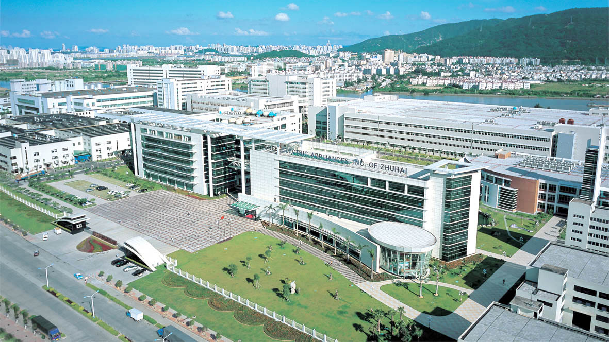
2020 GMV6 Multi VRF Unit
(General)

Slide 2
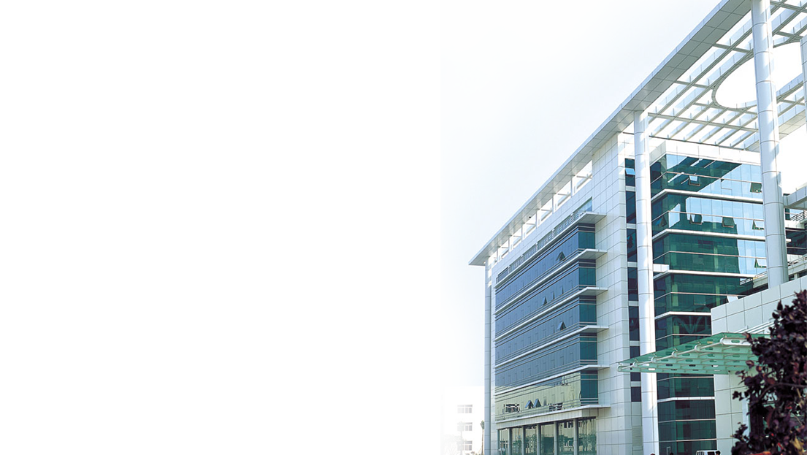
CONTENTS
PART 01
Product Introduction
PART 02
Typical Features
PART 03
Compare to Competitive Products

Slide 3
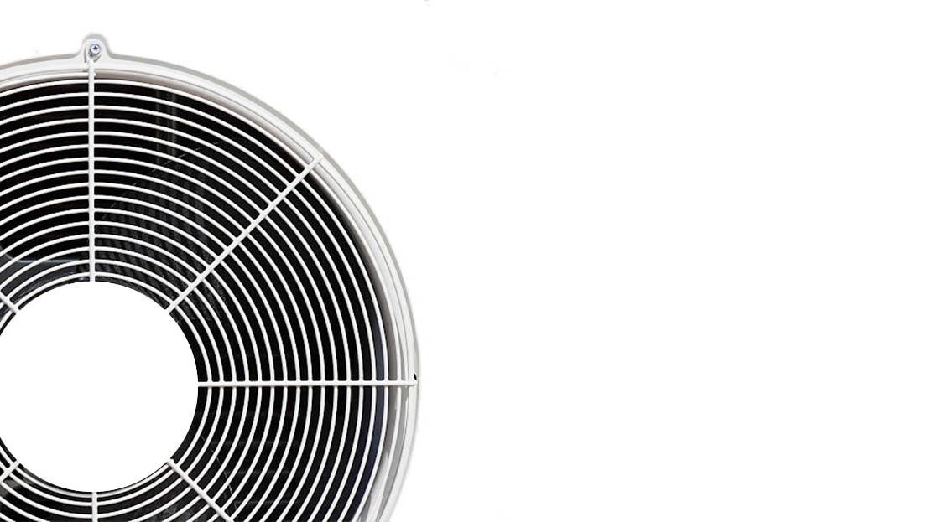
PART 01
Product Introduction
Overview
Core selling points

Slide 4
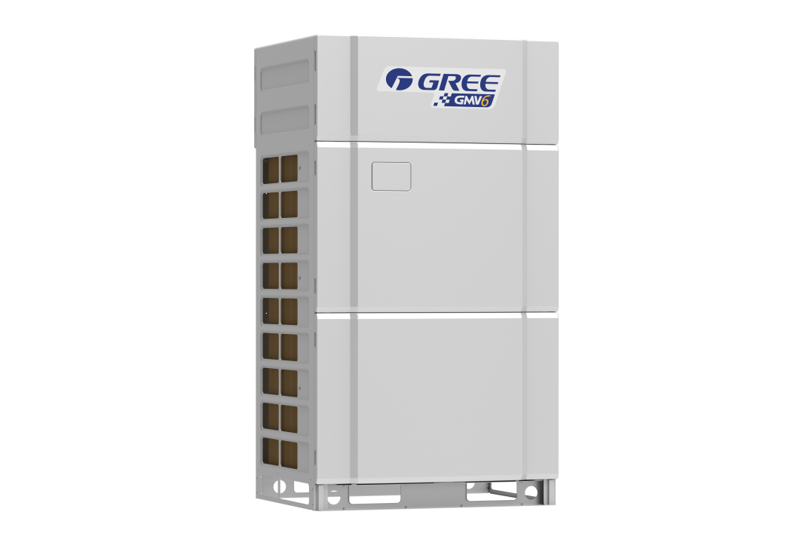
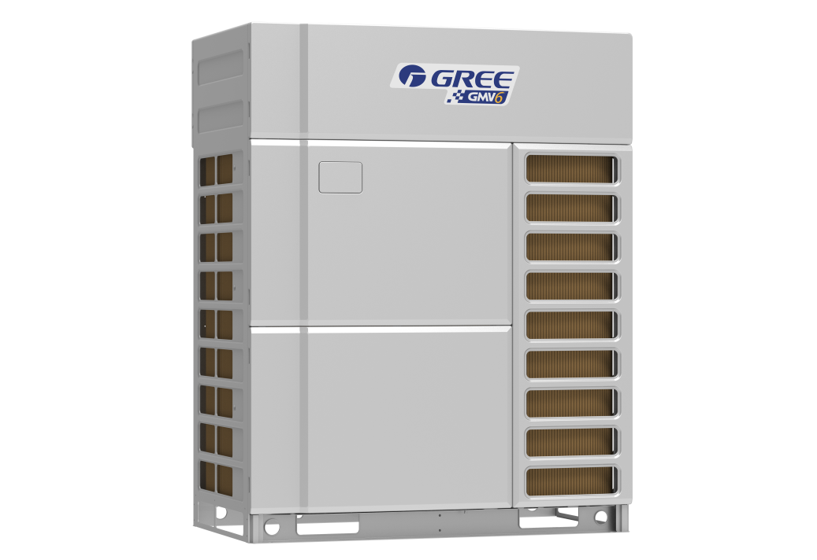
Overview
Product Introduction
Relying on the abundant technologies and the brand new efficient enthalpy-adding system design, Gree New Generation GMV6 Modular All Inverter Multi VRF System adopts the world-leading multi VRF CAN+ communication technology, low power consumption standby technology, intelligent and efficient control and other innovative technologies. Besides, new generation of intelligent management control solution and clean and healthy fresh air solution are attached as well, thus the unit is excellent in the aspects of energy conservation, comfort and stability. It is able to work under the wide range between -30℃~52℃ and the capacity is from 22.4kW to 272 kW. Therefore, it is widely used in villas, small shops, office buildings, shopping malls, supermarkets and some other business locations.

Slide 5
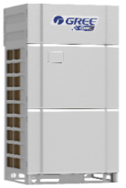
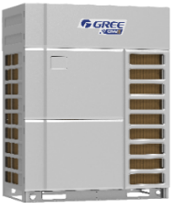
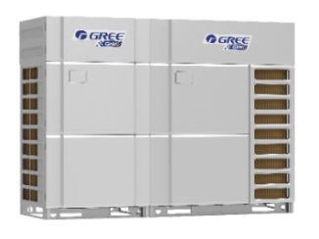
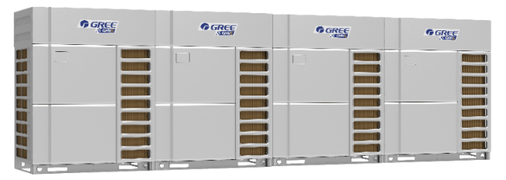
Overview
Product Introduction
Capacity HP | 8, 10, 12 | 14, 16 |  | 18, 20, 22,24 |  | 26 |  | …… | 96
Model | GMV-224WM/G-X GMV-280WM/G-X GMV-335WM/G-X | GMV-400WM/G-X GMV-450WM/G-X |  | GMV-504WM/G-X GMV-560WM/G-X GMV-615WM/G-X GMV-680WM/G-X |  | GMV-335WM/G-X + GMV-400WM/G-X |  | …… | GMV-680WM/G-X*4
External look |  |  |  |  |  |  |  | ……
Core features | Excellent performance |  | Intelligent control and management |  | Clean and healthy fresh air |  | Stable, reliable |  |  | Adaptable, flexible
 | ① High-efficiency low-temp enthalpy-adding technology ② New type heat exchanger design ③ Intelligent control ④ Strong cooling/heating technology ⑤ Noise control technology |  | ①GREE Remote Monitoring System ②GREE Wireless Remote Monitoring System ③GREE Intelligent Billing System ④Multiple protocol gateways ⑤Local centralized control solution |  | ①Fresh Air system ②ERV system ③ERV + DX coil ④High-efficiency Filter |  | ① CAN+ communication technology ② Self-adapting drive control technology ③ Oil quality control technology ④ Oil circuit management technology ⑤ Compact structure ⑥ Super wide operating range |  |  | ① Large capacity, compact design ② Super high static pressure ③ Long connection pipe, large drop difference ④ Quick installation design ⑤ High degree of installation adaptability
Operating range | Cooling：-5℃~52℃ Heating：-30℃~24℃

Slide 6
Core selling points
Product Introduction
Excellent performance
High-efficiency low-temp enthalpy-adding technology
Stable and reliable
CAN+ communication technology
Flexible engineering design
Intelligent control and management
New type heat exchanger design
Intelligent control
Strong cooling/heating technology
Noise control technology
Self-adapting drive control technology
Oil quality control technology
Oil circuit management technology
Compact structure
Super wide operating range
GMV6
4 cores
Distributed remote central
control system
Multiple gateway protocols (Modbus\KNS\BACnet\Modbus mini)
Intelligent billing calculation system
Local centralized control solution
Large capacity configuration
High adaptability
High piping adaptability
High installation adaptability
Convenient installation
Intelligent debugging
Convenient maintenance
Efficient management

Slide 7

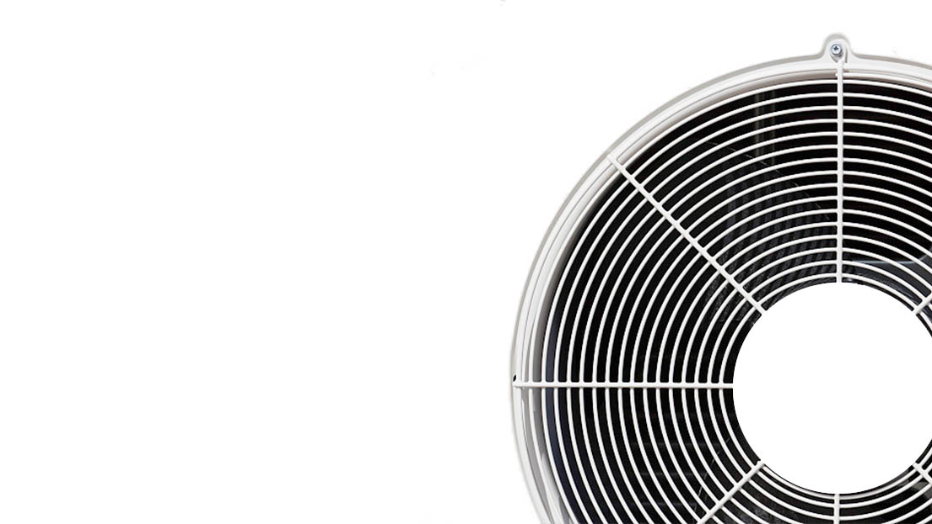
PART 02
Typical Features
Excellent performance
Intelligent control and management
Clean and healthy fresh air
Flexible engineering design
Stable, reliable
Convenient installation

Slide 8
Excellent performance
Typical Features
Excellent performance
1
2
3
4
5
Efficient and powerful
Efficient heat exchange
Intelligent and efficient control
Strong cooling and heating technology
Noise control
New type compressor;
Dual EEV enthalpy-adding control;
Multi EXV technology;
High-efficiency heat exchanger;
Layered dual-zone heat exchange;
large-flow fan
Double energy-saving modes;
HPAC efficient modular control;
SRL load self-adapting control;
Intelligent refrigerant circuit control;
Low-noise air duct;
Sound absorption, sound insulation;
Enthalpy-adding pulse control;
Refrigerant flow noise reduction;
Intelligent quiet control
New generation intelligent defrosting

Slide 9
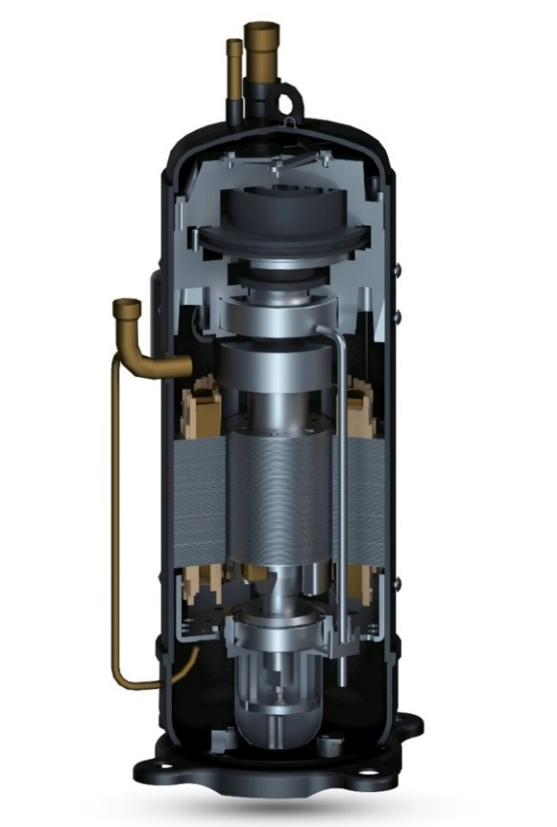
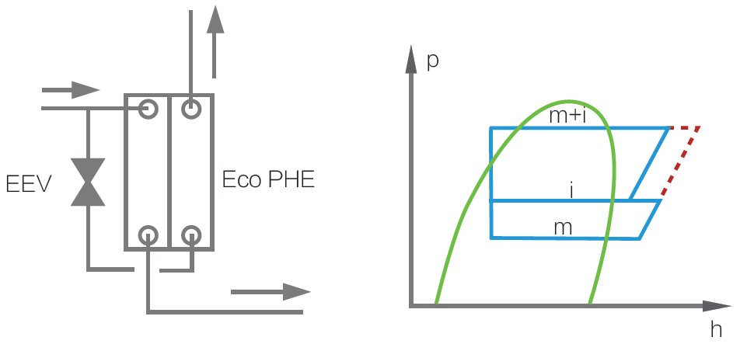
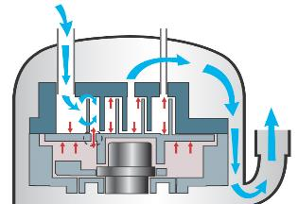
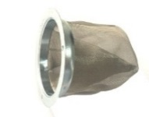
Excellent performance
Typical Features
① Efficient low-temp enthalpy-adding system——New type compressor
Specially designed for VRF units, it can improve cooling capacity and energy efficiency .
1 Enhanced vapor injection(EVI)
Improve system capacity, expand operating range, increase heating speed
2 Pressure relief valve
Improve partial load efficiency, adapt to
transformer ratio, improve product performance
1
Air suction
Hi. pressure
Vapor injection
2
Structure of relief valve
Low pressure
Discharge pressure
Relief valve
Mid pressure
Air discharge
3
Open valve
Compr. pressure
Fixed
4
Compressor cavity pressure＞discharge pressure
3 Optimized asymmetric vortex line
New asymmetric vortex line to reduce leakage loss,
reduce inhalation and overheating.
It is more suitable for APF conditions and improves
system efficiency.
5
4 Internal oil circulation
Internal oil circulation to reduce heat loss,
reduce fuel injection rate, improve efficiency
and reliability.
6
5 Dynamic oil balance
Patented oil balance technology, highly reliable,
flexible, no installation restrictions. It can be used
in parallel with compressors of different displacement and speed.
8
6 High speed
0~140rps variable speed,
a wide range of capabilities
7
8 Volumetric gear pump
Ensure necessary oil supply at variable speed
and improve compressor reliability.
7 Oil pump filter
Filter impurities to ensure clean oil supply.

Slide 10
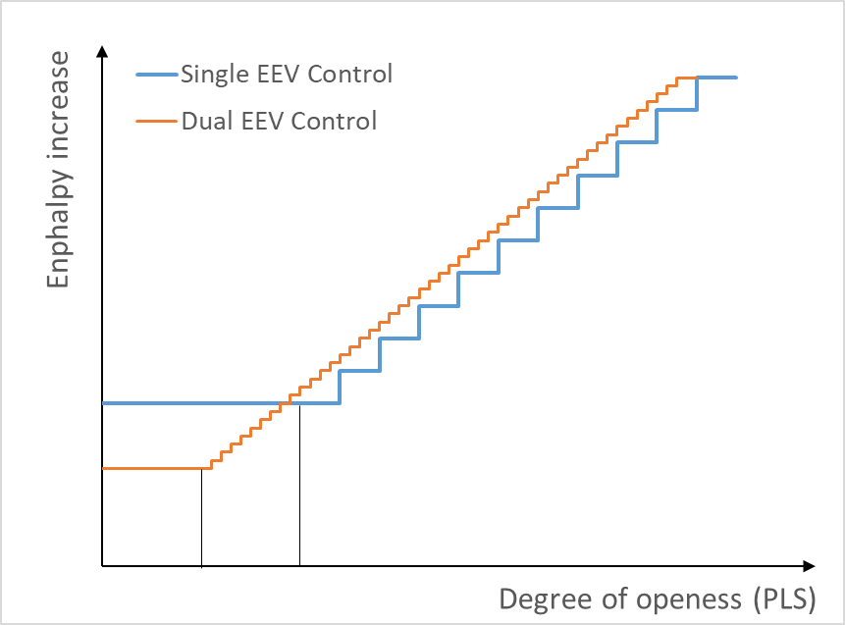
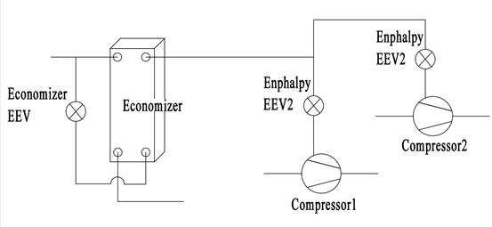
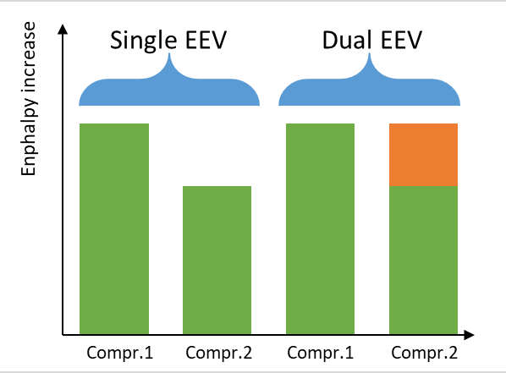
Excellent performance
Typical Features
① Efficient low-temp enthalpy-adding system——Dual EEV enthalpy-adding control
2400-step precise adjustment, wider adjustment range, more stable;
Dual-compressor system to flexibly adjust the amount of enthalpy increase between compressors, to maximize enthalpy increase;
Plate type economizer, higher heat exchange efficiency

Slide 11
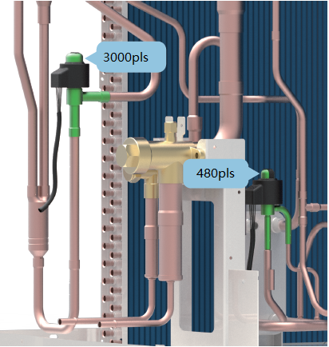
Excellent performance
Typical Features
① Efficient low-temp enthalpy-adding system——Multiple EEV flow control
Multi EXV control technology
EXV is one of the 4 basic parts of the air conditioner. It is not only a throttle but also a device to adjust the flow rate of refrigerant entering the evaporator. The wider the adjustment range, the higher the accuracy.
ODU adopts dual EXV control. The main EXV is a 3000-step EXV whilst the sub-cooling EXV is a 480-step EXV. They can precisely control the flow between IDU and ODU.
IDU adopts silent type EXV control. It can precisely control the flow of refrigerant. The adjustment is smooth and stable, improving comfort and system reliability.

Slide 12

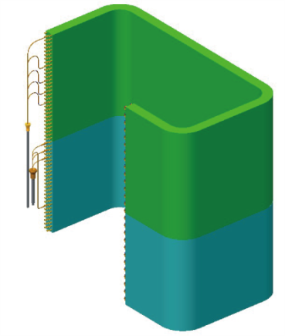
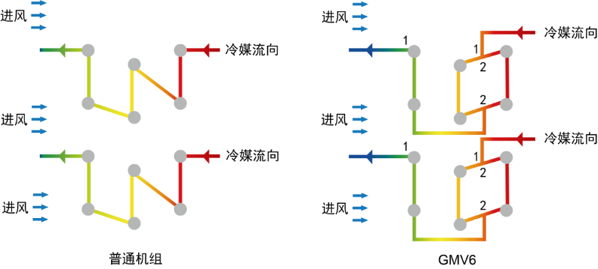
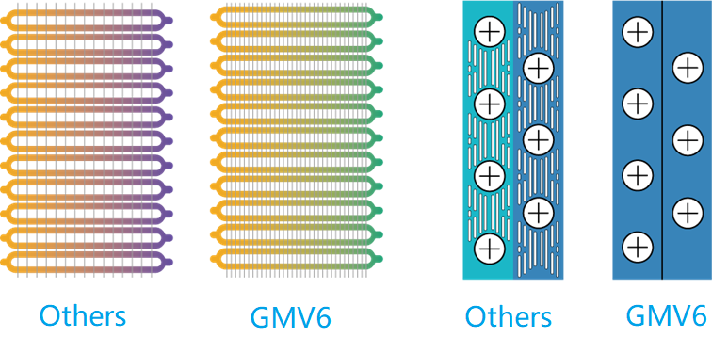
Excellent performance
Typical Features
② Efficient heat exchange——Efficient heat exchanger
Corrugated small pitch heat exchange fins
The overall heat exchange efficiency is higher;
Less fin section, stronger corrosion resistance;
Corrugated hydrophilic design, easier defrosting;
② Efficient heat exchange——Layered dual-zone heat exchange
According to the characteristics of the wind field, the heat exchanger is divided into different zones. The upper and lower levels adopt different capillary tubes. With the 1-2-2-1flow path design, the efficiency is higher.
Air flow
Air flow
Refrigerant flow
Refrigerant flow
Air flow
Air flow
Refrigerant flow
Refrigerant flow
Air flow
Air flow
GMV5
GMV6
GMV5
GMV6

Slide 13
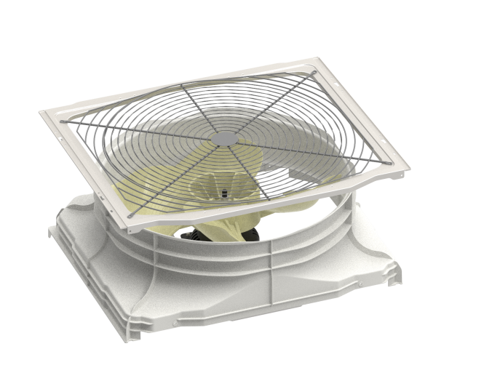
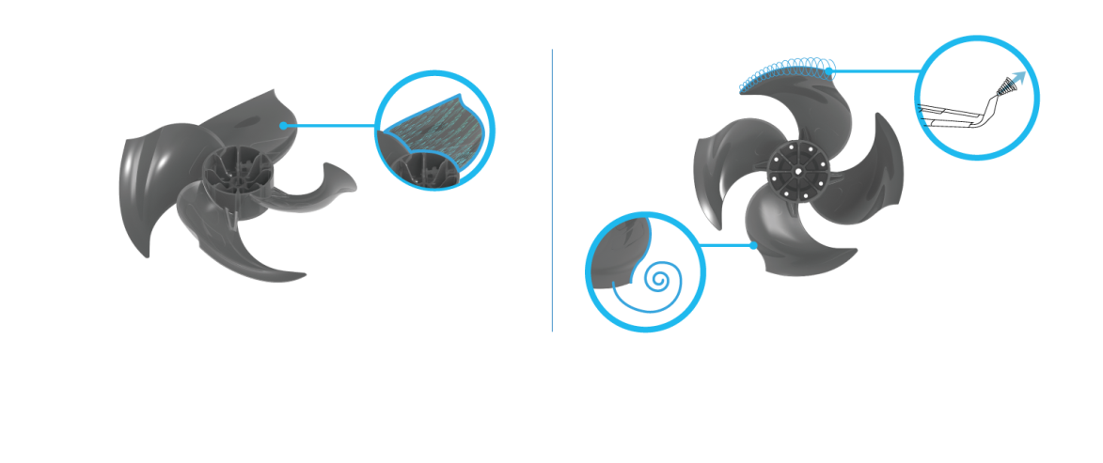
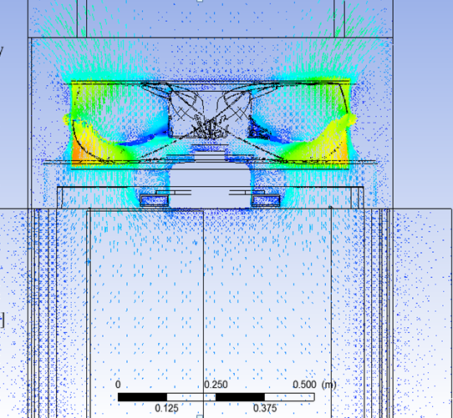
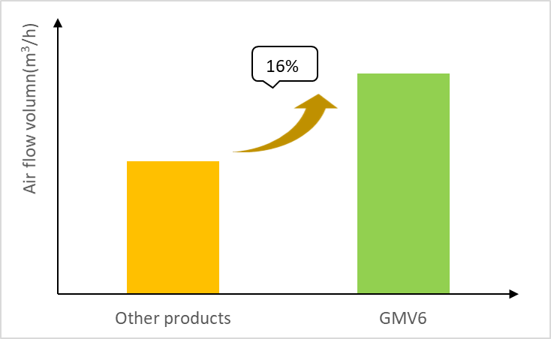
Excellent performance
Typical Features
② Efficient heat exchange——Large flow air duct
Optimized fan blade design to increase blade forward curve, suppress eddy current and reduce leakage.
The reversed S-shaped tail design effectively increases the work area of the blades and greatly increases the air volume.
New type air grille, with air output area up by 7.8%
Compared to other conventional units,
the air volume of GMV6 is up by 16%.

Slide 14
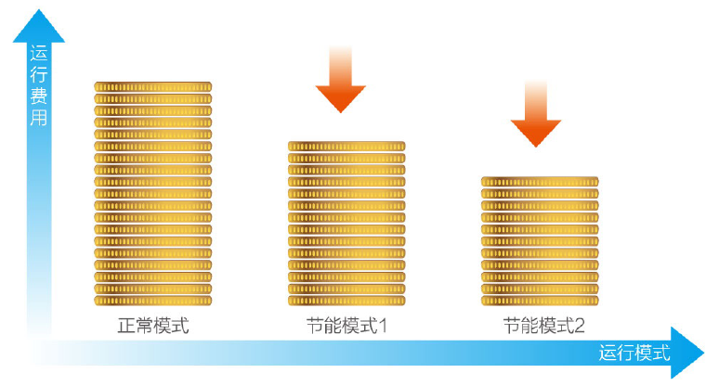
Excellent performance
Typical Features
③ Intelligent efficient control——Double energy-saving modes
GMV6 offer a variety of operating modes for users to meet the requirements for power supply in peak time.
Capacity first: If there is sufficient power supply, priority is given to meeting the capacity needs. This mode is default factory setting.
Auto energy-saving: System will automatically adjust parameters and balance the capacity and energy consumption according to the running state.
Forcible energy-saving: Capacity output of ODU is limited. Depending on power consumption and user needs, a 90% or 80% capacity ratio can be selected.
Operation cost
MAX15%
MAX20%
Capacity first
Auto energy-saving
Forcible energy-saving
Running mode
Note: When the above energy-saving modes are set, cooling capacity and heating capacity will decrease by 10%~20%.

Slide 15

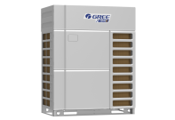
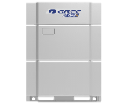
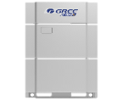
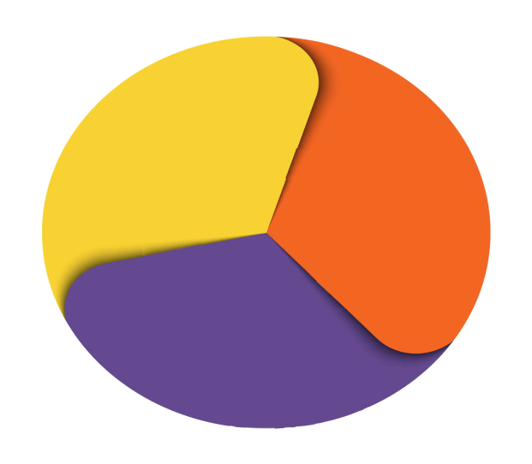
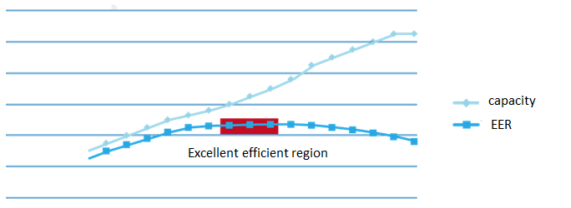
Excellent performance
Typical Features
③ Efficient intelligent control——HPAC efficient modular control
GMV6 adopts HPAC new modular control to adjust the distribution method according to the indoor load demand, to ensure maximum energy efficiency.
Compr.
IDU heat exchanger
ODU heat exchanger
Conventional control
GMV6-HPAC control
There is optimum matching between the compressor, indoor heat exchanger and outdoor heat exchanger. The indoor and outdoor heat exchanger capacity are automatically matched and adjusted in real time according to system operating conditions.
HPAC: high performance alternate control.

Slide 16
Excellent performance
Typical Features
③ Intelligent efficient control——SRL load self-adapting control
SRL(Self-Reaction Load): intelligently detect and control refrigerant pressure and temperature according to user status and indoor temperature changes, automatically adapt to indoor cooling and heating load and achieve energy-saving balance control.
Cooling mode
Heating mode
General power change
General power change
SRL power change
SRL power change
SRL low pressure change
General high pressure change
SRL high pressure change
General low pressure change
Expected indoor temperature
Actual indoor temperature
Expected indoor temperature
Actual indoor temperature

Slide 17
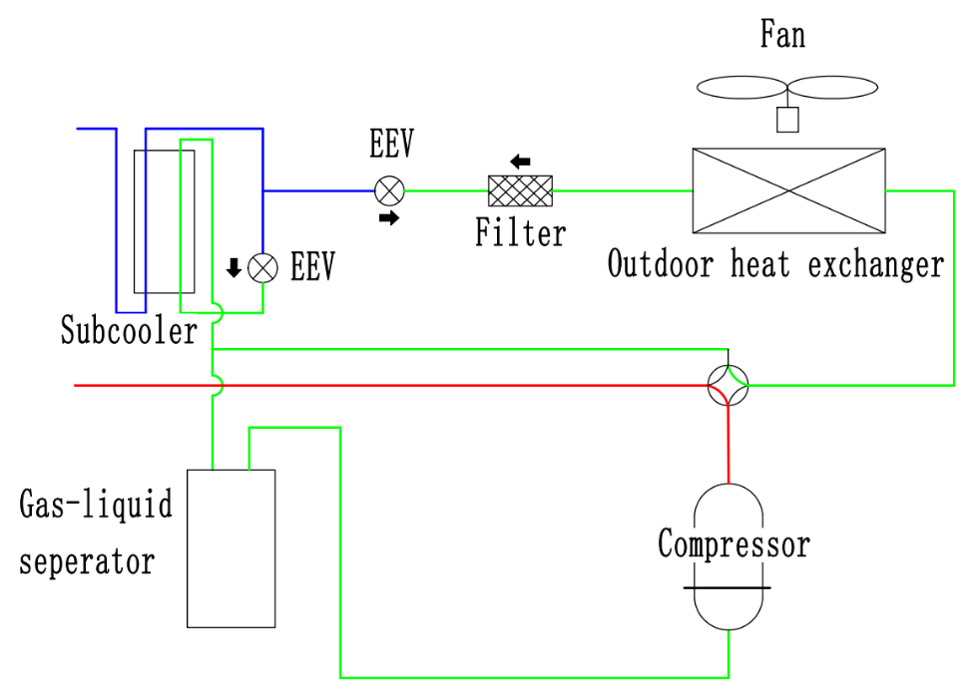

Excellent performance
Typical Features
③ Intelligent efficient control——Intelligent refrigerant circuit control
Low-temp refrigerant transfer technology
Intelligently judge whether the amount of refrigerant circulation is sufficient according to system parameters (pressure, temperature, speed, etc.). Refrigerant transfer is performed automatically. The heating capacity during the start-up process is increased by 15%.
Judge in operation
Pressure control
Large heat exchange temperature difference control
Low-temp liquid refrigerant
Low-temp liquid refrigerant

Slide 18
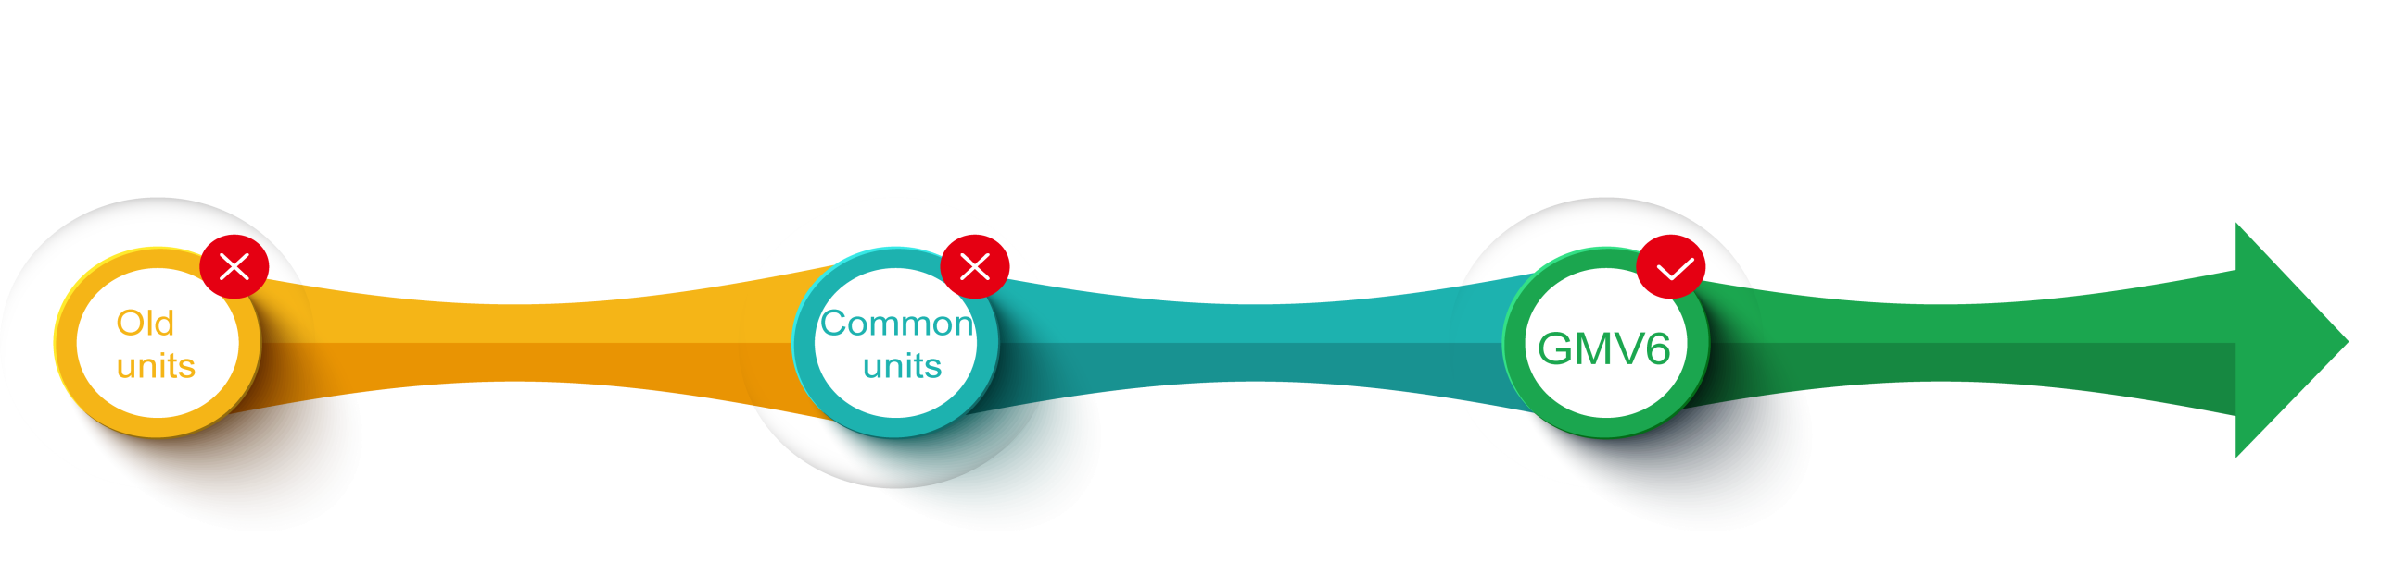
Excellent performance
Typical Features
④ Strong cooling and heating technology——New generation intelligent defrosting
Advancement of defrosting technology
Time defrosting
Sense temperature/ pressure to defrost
Intelligent defrosting
Defrost at a preset time, regardless of frost.
Defrost according to tube temperature and system pressure.
Variable period, variable defrosting capacity
Work load rate
Sys. temp & pres.

Slide 19
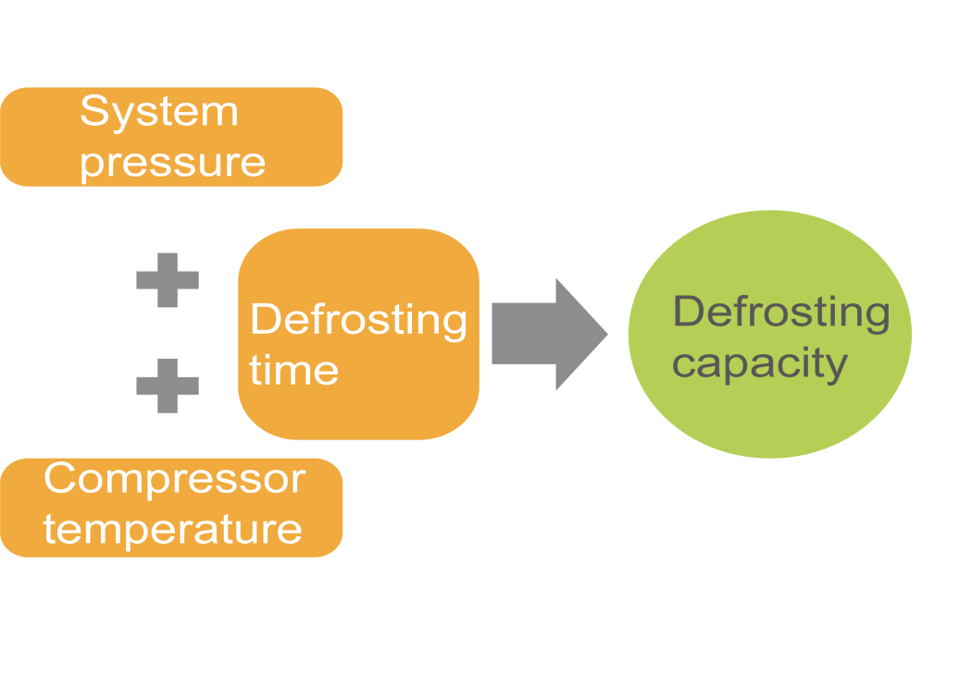

Excellent performance
Typical Features
④ Strong cooling and heating technology——New generation intelligent defrosting
●Engineering self-adapting control
Variable defrosting capacity
Defrosting speed is closely related to compressor output. In general, the unit will limit the output capacity of compressor during defrosting, which would lead to long defrosting time or abnormal defrosting.
GMV6 can automatically change the output capacity during defrosting by real-time parameter learning and judgment, so as to achieve stable or fast defrosting.
MAX 20%

Slide 20
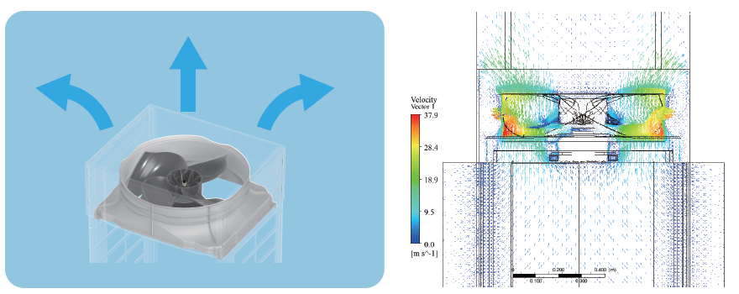
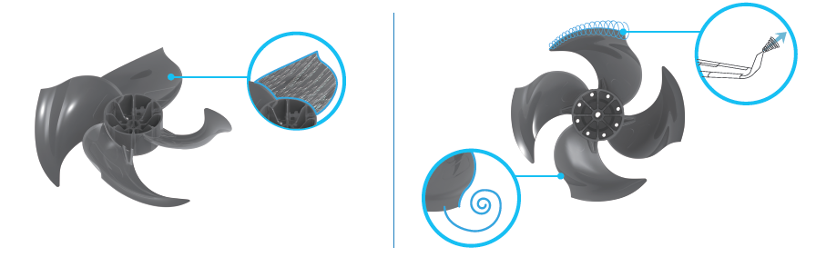
Excellent performance
Typical Features
⑤ Noise control technology——Large-flow and low-noise air duct
Large air volume and low noise fan: The reversed S-shaped tail design effectively increases the work area of the blades and greatly increases the air volume. Tail of the blade is designed from the winglet of the aircraft, which can effectively suppress the tip vortex generated by the wing tip pressure difference and reduce noise.
Immersed layout for the air duct: The whole air duct system is sunk and the whole structure is an immersed structure, which can effectively reduce wind noise and improve the convenience of transportation.

Slide 21
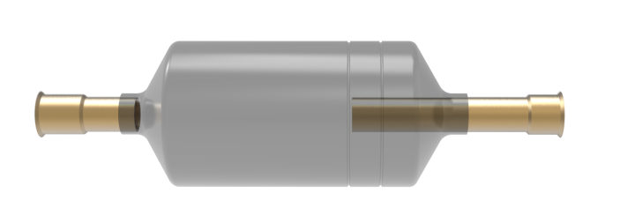
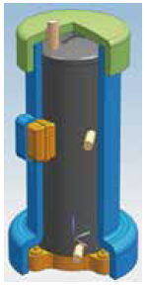
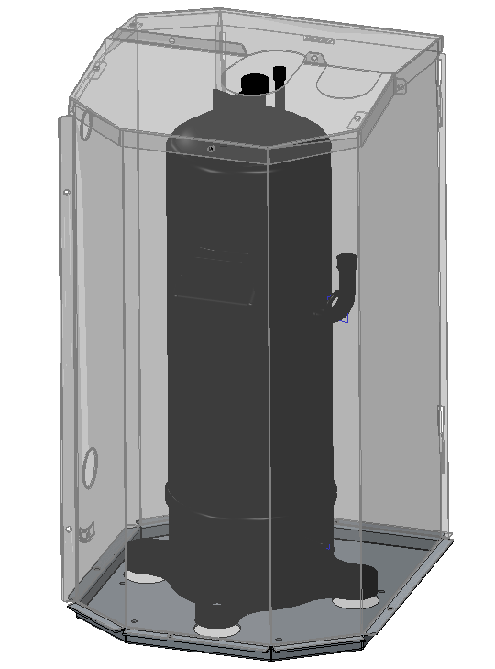
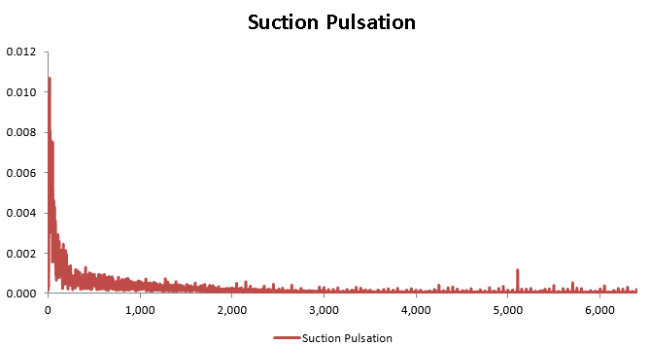
Excellent performance
Typical Features
⑤ Noise control technology——Sound absorption & Sound insulation，Enthalpy-adding pulse control
we use the new sound absorption materia and the new sound absorption material. The structure is an integrated structure and cooperates well with the compressor.
According to the sound intensity cloud and the pulsation characteristics of the unit, we develop the enthalpy-adding pulse buffer silencer.
New type silencer
Integrated type sound absorber
Metal sound-proof enclosure
*Some models have

Slide 22
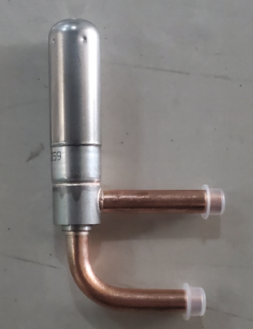
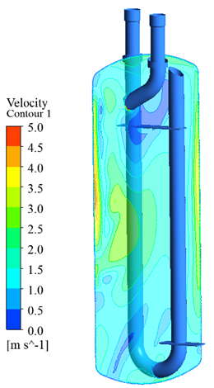
Excellent performance
Typical Features
⑤ Noise control technology——Refrigerant flow noise reduction
GMV6 uses three major refrigerant flow noise reduction technologies for further improving user experience.
●Refrigerant status control
According to the mechanism of refrigerant flow noise, we adopt efficient sub-cooling and overheating technology to effectively prevent the two-phase refrigerant from generating throttling noise and eddy current noise.
Two-phase gas and liquid refrigerant
General control
Single-phase liquid refrigerant
Special control
●Use silent throttle unit
The indoor unit adopts a specially-designed silent throttle unit and a silent expansion valve, which can satisfy step-down flow distribution and reduce throttling noise to the max.
●Use silent gas separator
This is a specialized low-noise large-volume gas liquid separator. The shape and angle of the inlet and outlet pipes are specially designed for variable load conditions. It can effectively reduce the impact and airflow noise of gas and liquid separation.

Slide 23
Excellent performance
Typical Features
⑤ Noise control technology——Intelligent quiet control
It can learn, define and remember user habits.
Define user habits | User startup repetition rate | User startup quantity rate
Habit 1 | ≥90% | User startup quantity rate for a days ≥X%
Habit 2 | ≥90% | X>User startup quantity rate for b days ≥Y
…… | …… | ……
It can automatically determine the output capacity of the system in the next 24 hours to achieve auto quiet operation.
Learning and defining
Intelligent quiet operation
Intelligent quiet operation
Status changed, learning again
Down by 3dB(A) at most
Actual load demand W
(depend on outdoor temperature T and difference from indoor temperature ∆T）
Restore normal output
Normal output
Intelligent output adjustment
System capacity output Q

Slide 24
Intelligent control and management
Typical Features
Intelligent control and management
1
2
3
4
5
6
GREE Wireless Remote Monitoring System
GREE Intelligent Billing System
Multiple protocol gateways
Local centralized control solution
Overview of Intelligent Control
GREE Remote Monitoring System

Slide 25
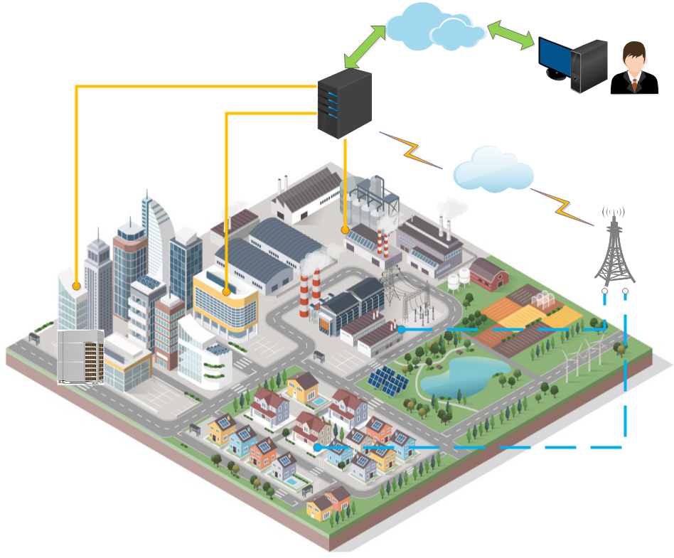
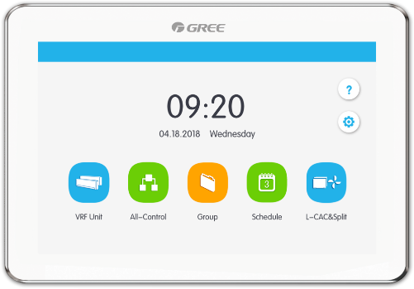
Intelligent control and management
Typical Features
① Overview of Intelligent Control
Centralized management of equipment is currently the mainstream demand. Gree can provide multiple solutions to meet the needs of different scenarios
Wired solution
Provide wired solutions to solve the monitoring of a large number of centralized air conditioning equipment.
Wireless solution
Provide wireless solutions for fast and agile monitoring, suitable for difficult wiring situations, and for distributed monitoring.
*Due to the influence of local network system,the wireless monitoring scheme needs to be customized and developed.

Slide 26
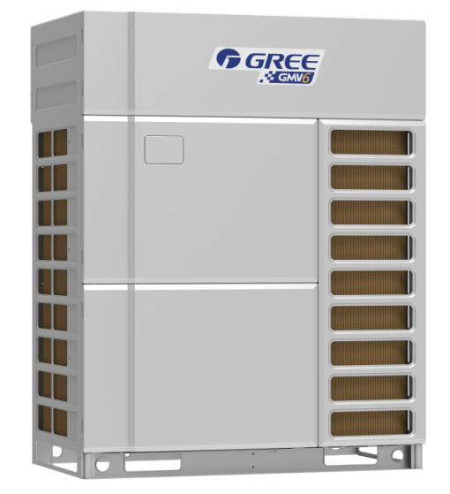
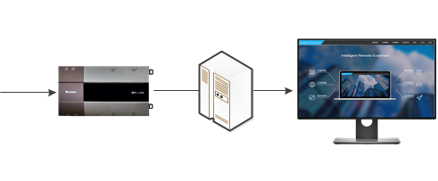
Intelligent control and management
Typical Features
② GREE Remote Monitoring System
Gree remote monitoring system provides wired monitoring solution for centralized management and monitoring of HVAC equipment;
This solution meets the air conditioning monitoring needs in multiple scenarios and facilitates property management.
Large-scale group control
The system can access 8160 internal machines
Responsive
Achieve second level control
Distributed networking
Distributed networking, meeting LAN and WAN
Multi-model support
Support multi-line, roof machine, u-match, hot water machine, large air duct

Slide 27
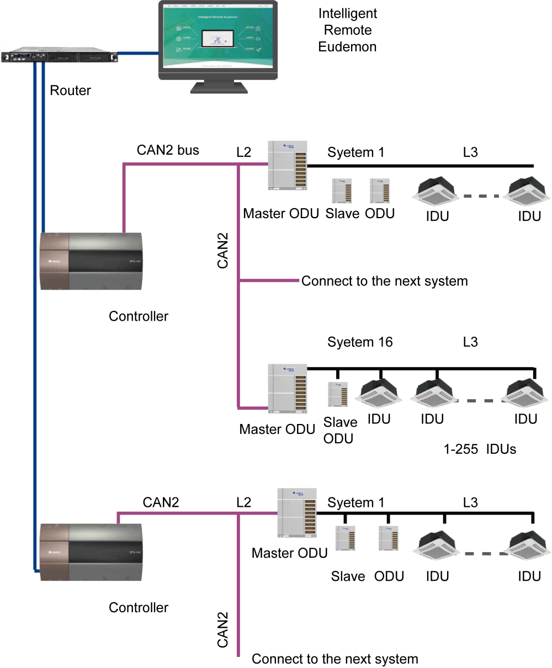
Intelligent control and management
Typical Features
② GREE Remote Monitoring System
System composition:
1、Computer
Install Intelligent Remote Eudemon software;
2、Remote monitoring controller
3、Router (switch)
4、Wires
1）Network wire: used to connect remote monitoring controllers and routers, as well as computers and routers;
2）shielded twisted pair: used to connect remote monitoring controller and air conditioning unit.
Note:
CAN1 bus: CAN1 bus is the communication bus between outdoor unit and indoor unit
.CAN2 Bus: The communication bus between units is CAN2 bus.
Unit system: A unit system consists of a set of outdoor unit(a set of outdoor units is a module group, which can be composed of 1-4 modules, i.e. 1-4 outdoor units) and its indoor units.

Slide 28
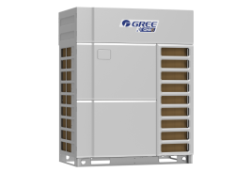
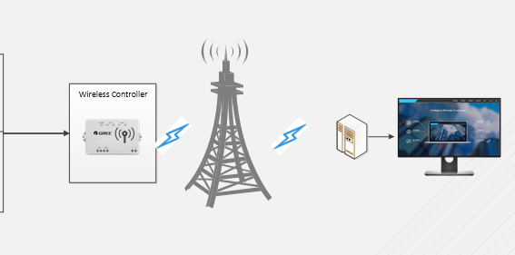
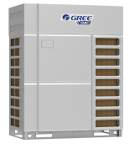
Intelligent control and management
Typical Features
③ GREE Wireless Remote Monitoring System
The wireless solution is suitable for the accurate monitoring of HVAC equipment. This solution meets the air conditioning monitoring requirements in special scenarios. The installation is simple, especially suitable for scenes that cannot be wired in a large amount. Wireless monitoring can also be combined with Gree HVAC big data to achieve more convenient service.
Wireless monitoring
Wireless HVAC data acquisition and monitoring via wireless
Agile debugging
No wiring required, installation can be used, and the use of the scene is wide
Distributed management
As long as there is a wireless signal, it can be connected to the system to achieve unified management across the country.
Fault warning
Realize early warning of air conditioning failure and detailed data monitoring
*Due to the influence of local network system,the wireless monitoring scheme needs to be customized and developed.

Slide 29

Intelligent control and management
Typical Features
④ GREE Intelligent Billing System
Gree has launched GREE Intelligent Billing System to solve the problems of multi VRF power consumption statistics and user electricity bill distribution, which provide accurate and reasonable charging basis for property management.
Accurate billing
1）The administrator can obtain the power consumption of each indoor unit.
2）User can set the billing time period and its electricity price as needed.
3）Provide detailed billing, operation details and other reports.
Remote control and management
1）One-button control device.
2）Monitor the fault condition in real time and report the fault information immediately.
Multi-meter compatibility
1）Compatible with 5 types of ammeters to meet the requirements of global customers.

Slide 30

Intelligent control and management
Typical Features
④ GREE Intelligent Billing System
A set of GREE Intelligent Billing System includes:
1、Computer
Install Intelligent Billing Eudemon software;
2、Power Billing Gateway
3、Router
Support the DHCP function (can automatically assign IP addresses); ensure the computer and the gateway in the same network segment; ensure the normal communication between the computer and the gateway.
4、Ammeter
Measuring the electricity for the outdoor unit of air conditioner.
5、Wires:
1) Network cable: Use for connecting the Power Billing Gateway and the router, and connect the computer and the router;
2) Shielded twisted pair: used to connect the Power Billing Gateway and the air conditioning unit, and connect the Power Billing Gateway and the ammeter.
Note:
CAN1 bus: the communication bus between the outdoor unit and the indoor unit is CAN1 bus;
CAN2 bus: the communication bus among the units is CAN2 bus;
Unit system: A unit system is composed by a set of external units ( a unit system is composed by a set of outdoor unit (a set of outdoor unit is a module group, which consists of 1-4 modules, that’s 1-4 outdoor units) and its indoor units.

Slide 31
Intelligent control and management
Typical Features
⑤ Multiple protocol gateways
Provide multiple protocol gateways
Multi-model support
product type | product | model
BACnet gateway | BACnet Gateway（IP） | ME30-24/D4(B)
Modbus gateway | H2M Gateway | ME31-33/EH1(M)
 | Modbus Gateway（TCP） | ME30-24/E5(M)
 | Modbus Gateway（RTU） | ME30-24/E6(M)
KNX gateway | S2S KNX Gateway | ME30-24/F1(K)
Support multi-line, roof machine, umatch, hot water machine, large air duct
Multi-machine protocol support
Support Modbus, BACnet, KNX and other protocols
Third party BMS system docking
Dockable smart home and BMS system
Modbus Gateway TCP
BACnet Gateway
Modbus Gateway RTU
H2M Gateway
S2S KNX Gateway

Slide 32

Intelligent control and management
Typical Features
⑥ Local centralized control solution
Support single system and multi-system centralized management
Support both CAN and Modbus networks, covering VRF, U-Match, Free-Match, Mini-Split models
CAN network supports up to 16 systems and 255 indoor units
Modbus network supports up to 36 indoor units

Slide 33
Intelligent control and management
Typical Features
⑥ Local centralized control solution
7" high resolution color LCD display, full capacitive touch control
One button all open / all off
Single/centralized management, group management, schedule management
Indoor unit sorting, energy saving setting, real-time display of indoor and outdoor units
Supported languages: Chinese Simplified, Chinese Traditional, English, Spanish, French, Portuguese, German, Turkish
Support VRF, U-Match, Free-Match, Mini-Split models at the same time
up to 255 GMV+36 other LCAC Units

Slide 34
Clean and healthy fresh air
Typical Features
Clean and healthy fresh air
1
2
3
4
Fresh air system
ERV system
ERV + DX coil
High-efficiency Filter

Slide 35




Clean and healthy fresh air
Typical Features
①Fresh air system
Fresh Air Processing Indoor Unit：1200～4000m³ / h air volume, widely used in villas, high-end communities, commercial places, and large public places.
Completely fresh, comfortable and natural
50-300Pa
Capacity 14-45kW
Cassette Indoor Unit：Optional fresh air fitting can effectively introduce 8 ~ 10% of outdoor fresh air and improve indoor comfort.

Slide 36




Clean and healthy fresh air
Typical Features
② ERV system
Fresh air purification + energy recovery
Indoor air exhaust
Air exhaust
Constant air volume control to ensure that the air volume does not decay within a certain range of external static pressure
Multiple control method: manual control; VRF unit linkage control; automatic detection control
Air volume:150-500m³/h
Five modes, switch freely
Outdoor fresh air
Fresh air
CO₂ concentration
PM2.5
Temperature
Humidity
Air box

Slide 37

Clean and healthy fresh air
Typical Features
③ERV + DX coil
After the indoor exhaust (yellow exhaust) enters the unit, it will enter the filter, then enter the heat exchange core for heat exchange, and then send it out through the exhaust fan.
exhaust fan
filter
ventilation fan
After the indoor air supply (green fresh air) enters the unit, it will also enter the filter, and then enter the heat exchange core for heat exchange. The fresh air is blown into the heat exchanger for further processing and then sent to the room.
heat exchange core
filter
heat exchanger

Slide 38
Clean and healthy fresh air
Typical Features
③ERV + DX coil
high-efficiency heat exchange
XE70-33/H dot matrix wired controller
Built-in high-efficiency hexagon heat exchanger, which can recover the energy from indoor exhaust, reducing the energy efficiency of fresh air, eco-friendly and energy-saving.
The dot matrix wired controller is compatible with both the indoor unit and the new, which can realize both IDU control and ERV control.
Air volume without attenuation
With both cooling and heating functions
The unit adopts constant air volume control, which can keep constant air volume within the range of rated static pressure without attenuation of air volume, to achieve high-efficiency ventilation.
Built-in integrated heat exchanger, which can realize temperature control of air supply without external equipment, simple and energy-saving.
filter auto replacing and washing remind
Multiple operating control modes
The system can automatically calculate the using period of filter and remind the user to replace and wash the filter.
Multiple operating control modes are designed for the unit, including linkage, free cooling, group control, etc., greatly improving the applicable locations.

Slide 39


Clean and healthy fresh air
Typical Features
④High-efficiency Filter
High-efficiency purification filter can effectively filter PM2.5 and meet the national standard high and medium efficiency level (70% ~ 95%).
Small air resistance and less volume attenuation.
Use flame retardant materials to meet fire protection requirements;
With 5 disassembly directions for convenient replace and installation.
*It should be customized, optional fitting for SDB series indoor units.

Slide 40
Stable, reliable
Typical Features
Stable, reliable
1
2
3
4
5
6
Advanced CAN+ communication
Technology
Self-adapting drive control
Oil system control
Rotation control
Compact structure
Cooling system high adaptability

Slide 41

Stable, reliable
Typical Features
① Advanced CAN+ communication Technology——Innovated Stratification CAN+ Multiple Master Network Structure
For the application features of air conditioner that with multiple nodes, multistep control and intelligent expansion, innovative stratification CAN+ multiple master network structure, to realize relative improvement of nodes number of single system by 56%, and response time for centralized control system is shortened by over hundreds of times.
Technical Effect |  | CAN+ Network Structure | Traditional Network Structure
Real-time capability of interaction | Communication cycle of single system | <500ms | About 5s
 | Preferential response | ms class | second class
 | Centralized control response time | 6s | 10min
Reliability of interaction | Error isolation | Automatic | No
 | Impact of node malfunction | Not rely on any node | Totally rely on master unit
 | Sub-net scale | 100* | 64
Expansibility | Intelligent equipment | Free access | Require bridge connection
*Note: Customized engineering service is needed if there are more than 80 indoor units. Up to 100 indoor units can be connected.

Slide 42
Stable, reliable
Typical Features
① Advanced CAN+ communication Technology——First Formulated CAN+ Communication Protocol
It is the first time to formulate and standardize CAN+ communication protocol: two-stage network universal design, data can be directly transferred; functional code, network address, data field and related core concepts are developed, realizing grading, classification and real-time transfer of communication data, satisfying the demand of intelligent expansion.
ID section（arbitration section in CAN protocol） |  |  |  |  |  | Data section（DATA）
11bits |  |  | 18bits |  |  | 8*N bits
4bits | 4bits | 3bits | 4bits | 7bits | 7bits | 8*N bits
Function code |  | CAN2 network addr. |  | CAN1 network addr. | Data type | Data section
Function extensibility: support 256 function types and priority levels |  | The number of devices is expandable: 128*128=16384 devices |  |  | Business data extensible: 128*256=32768 bytes

Slide 43
Stable, reliable
Typical Features
① Advanced CAN+ communication Technology——The First Nonpolarity CAN+ Communication Chip
      Good expansibility
Network scale: single system can control up to 100* indoor units, reducing equipment investment and management costs;
Instant use: new device can be accessed freely, with flexible engineering configuration;
Centralized control: two-stage CAN+ communication network structure, no bridge device is needed between the systems, and the centralized control equipment can control up to 16 systems.
* Note: Customized engineering service is needed if there are more than 80 indoor units. Up to 100 indoor units can be connected.
      High-efficiency and reliable
      Innovatively integrate the air conditioning control business with the bus arbitration mechanism to achieve second-level response of large centralized control system;
      With fault isolation function, the faulty node quits actively, and the network is not affected by the faulty node.
      Convenient installation commissioning
      With automatic addressing function, the system automatically assigns addresses without manual dialing and networking, saving time and effort;
      The interface is non-polar design, engineering wiring does not need to consider the positive and negative side, which is safe and reliable.

Slide 44


Stable, reliable
Typical Features
② Self-adapting drive control——
Variable load and frequency control
② Self-adapting drive control——
Strong torque start control
Based on the operating characteristics of the compressor, the load frequency is automatically switched to maximize efficiency and reliability.
No need for external balancer. Compressor torque self-feedback and adjustment control are adopted. The compressor can start under high pressure difference, ensuring system continuity and stability.
General startup failed
GMV6 startup

Slide 45
Stable, reliable
Typical Features
② Self-adapting drive control ——Flexible enthalpy-adding control
Generally, system adopts “0←→1”switching mode to switch between the increase and non-increase of enthalpy, which may lead to dramatic load change of the compressor, shutdown or even damage to the compressor.
GMV6 utilizes the linear flow variation features of EEV to gradually increase the load during enthalpy increase, and achieve stable and continuous operation.
Sudden overload
protection
Enthalpy-adding demand
Common solenoid valve control
GMV6 EEV flexible control
Common solenoid valve loading
Stable transition of loading
No enthalpy-adding demand
GMV6 EEV flexible loading

Slide 46

Stable, reliable
Typical Features
②Self-adapting drive control —— High voltage shock prevention technology
The larger the compressor capacity, the larger the current and the influence of the parasitic inductance. It may lead to lower stability and damage to components.
High voltage switching power + fully isolated drive technology, multi-channel output of electromagnetic isolation to avoid interference.
Circuit protection function is synchronously isolated and the desat setting suppresses transient spike currents.
Industrial performance and large-power drive, more secure and reliable.
Rectifier
inverter
DSP control
High freq. isolated switching power
Power
AD
sampling
Comm.

Slide 47


Stable, reliable
Typical Features
③ Oil system management——Double heating source oil temperature control technology
Under standby status, the compressor winding and external electric heating belt can independently or simultaneously conduct heating control of the refrigerant oil.
Variable control of motor winding heating power enables fast and safe start-up under different environmental conditions, and the preheating time is shortened from 8 hours to 2 hours.
Winding 3-gear heating
Shortened by 75%
2h
Winding 2-gear heating
Commissioning wait time
Motor winding
Winding 1-gear heating
External heating belt heating
8h
Oil temperature heating belt
Refrigerant oil

Slide 48

Stable, reliable
Typical Features
③ Oil system management——Double Backup heating
Under the condition that the external heating belt works abnormally in the GMV6 unit, the winding heating can also work normally to ensure the reliability of compressor.
Ordinary units only have external electric heating control. Once the electric heating is faulted, the probability of damage to the compressor is greatly increased.

Slide 49

Stable, reliable
Typical Features
③ Oil system management——Low-temp multi oil circuit management
6 major oil paths ensure the smooth and reliable oil circuit.
2. Main pipe oil path
Oil separator
Compressor
5. Balancing oil path
6. Heat exchanger oil path
1. Main oil path
4. Low-temp oil path
Throttling device
6. Heat exchanger oil path
3. Gas separator oil path
Gas liquid separator
Gas liquid

Slide 50



Stable, reliable
Typical Features
③ Oil system management——Differential pressure variable flow oil return
According to the different working conditions, differential pressure control factor is introduced. Based on the real-time operating parameters, system can achieve intelligent variable flow oil return to ensure maximum flow rate and duration of oil return and improve reliability.
Internal oil circuit
General oil return control
Abnormal exit, insufficient oil return time
Abnormal, under to enter oil return operation
Differential pressure variable flow oil return control
Differential pressure control, maximize the flow
Differential pressure control, ensure the oil return time
Refrigerant flow
Oil flow
When there is not enough oil, the lubricating effect will be poor and the compressor will be worn easily.

Slide 51

Stable, reliable
Typical Features
③ Oil system management——Self-balancing control without oil balance pipe
There is no need for external oil balance pipe. By collecting and calculating the capacity output and threshold of each module, the distribution of refrigerating oil is automatically controlled to ensure stable operation of the system.
GMV6

Slide 52


Stable, reliable
Typical Features
③ Oil system management——Active compressor oil drain control
When the system is running at low load, the compressor will actively raise the frequency to discharge the excessive refrigerating oil and store it in the oil separator. This will effectively ensure the heat dissipation of the compressor.
Motor temp.
T
Motor temp.
T-5
Oil drain operation

Slide 53


Stable, reliable
Typical Features
③ Oil system management——Module piping adaptive control
In terms of modular design, the ODU detects the parameters of each module and the system defines the drift module, memorizes the operating features of the drift module. Each module adjusts the control mode and control threshold of key components according to the difference in characteristics. They can memorize and quickly achieve efficient operation when being restarted the next time.
Normal module
Drift module
Normal module
Drift module
Normal module
Normal module
Drift module
Drift module
Module parameters
Adaptive control
Module parameters

Slide 54


Stable, reliable
Typical Features
④ Rotation control——Compressor rotation
In system control, the overall life of the modular units is considered. When there is not only one compressor, the internal compressors will work in turn to balance the service life of each compressor.

Slide 55



Stable, reliable
Typical Features
④ Rotation control——HPAC high-efficiency modularized control
GMV6 adopts brand new modularized control method to not only ensure the operating service life of whole unit, but also improve the overall operating energy efficiency.
8h
Xh
8h
Xh
8h
Xh
Ordinary control
X = cycle
Variable cycle control
HPAC: high performance alternate control.

Slide 56




Stable, reliable
Typical Features
⑤ Compact structure——Lntegrated intelligent PCB
Compact design and efficient processing technique to reduce space, increase the power density of the inverter, enrich functions.
Intelligent design: low power control, auto address allocation, auto debugging, fault memory and query;
High reliability: wide voltage range, multiple protections against lack of phase, reversed phase, overload, surge, static electricity; moisture-proof, dust-proof, corrosion-proof;
GMV6
GMV5
Advanced production and inspection technology
The controller board receives SMT processing—AOI optical inspection—ICT online inspection—FCI functional test—DCT test and vibration+ stress test, etc. the strict manufacturing and inspection process ensures that the control board can withstand high temperature, high humidity, wear and tear and drop and other adverse conditions.
Front
Back
The board receives SMT processing
SMT workshop with constant temp and hum.
Stress test simulation curve

Slide 57




Stable, reliable
Typical Features
⑤ Compact structure——New electrical components
With the integral design, the overall size is reduced by 35%. Installation is more convenient.
The electric control structure adopts Al. alloy with high thermal conductivity. The reinforced heat transfer improves the internal heat dissipation, and guarantees the reliable operation of the high speed inverter compressor.

Slide 58

Stable, reliable
Typical Features
⑥ Cooling system high adaptability——Ultra-low temp startup control
TURBO low-temp flow prediction algorithm is based on the control of intermediate pressure. The compressor, fan and EEV components accelerate refrigerant circulation according to the features of low-temp refrigerant.

Slide 59

Stable, reliable
Typical Features
⑥ Cooling system high adaptability——Ultra-low temp running control
Low-temp low-pres. liquid refrigerant circulation control
-40℃ evaporation temp. control
Low-temp. large temperature difference heat exchange control
EVI gas and liquid mixed control
Pres. ratio load dynamic control
High-speed and stable operation of compressor
Gas separator, liquid refrigerant

Slide 60

Stable, reliable
Typical Features
⑥ Cooling system high adaptability——Low-temp anti-freezing control
The hot gas bypass at the bottom of the heat exchanger adopts anti-freezing design to achieve effective drainage and stable operation under low temperature.

Slide 61

Stable, reliable
Typical Features
⑥ Cooling system high adaptability——Advanced liquid strike prevention tech
The high-efficiency and large-capacity gas liquid separator can effectively separate gas and liquid refrigerant and avoid a large amount of refrigerant being directly sucked into the compressor. By judging liquid return based on the suction and discharge temperatures, the compressor and EEV will adjust in time to prevent liquid strike.
Disch. temp. & pres.
Fan output
Safe and reliable operation
Liquid return judgment, oil temp. judgment
Flow regulating parts, EEV control
Suct. temp. & pres.
Compr. output

Slide 62

Stable, reliable
Typical Features
⑥ Super-wide working range——Wide Operation Range
-30℃-52℃ stable operation to provide users with comfortable environment in both cold and hot weather, operating ambient temperature for cooling can be as low as -15℃.
Note: For specific operation conditions of -15℃ low temperature cooling operation please inquire engineering technician. General lowest operating temperature for cooling is -5℃.

Slide 63
Flexible engineering design
Typical Features
Flexible engineering design
1
2
3
4
Large capacity configuration
Highly adaptable fan system
High piping adaptability
High installation adaptability

Slide 64



Flexible engineering design
Typical Features
①Large capacity configuration——Wide capacity design
The maximum capacity is increased, which can better adapt to the needs of the project and improve the construction efficiency!
GMV5
Increase
Up to 9%
8HP
24-88HP
GMV6
8HP
26-96HP

Slide 65







Flexible engineering design
Typical Features
② Large capacity configuration——Compact size
—— | GMV5 | GMV6 | Floor space | Result
335 |  |  | 29%↓ | Lower the requirements for engineering applications; save more space
680 |  |  | 40% ↓
The whole series range from 8HP to 24HP. They can enter residential elevators easily, reducing engineering cost.
1690mm
1690mm
2000mm（gate height）
1400mm
775mm
930mm
775mm
800mm（gate height ）
1340mm

Slide 66

Flexible engineering design
Typical Features
③ Highly adaptable fan system——Super-high static pressure design
（1）New type of guide casing: effective coupling with the fan, for more balanced flow;
（2）The air grill adopts vortex streamlined distribution to reduce wind resistance;
（3）High-efficiency motor with strong output;
110Pa
—— | GMV5 | GMV6 | Increase of static pressure | Result
External static pressure | 82Pa | 110Pa | 34% | Lower the requirements for engineering applications; more convenient for equipment layer design

Slide 67



Flexible engineering design
Typical Features
③ Highly adaptable fan system——Fan anti-wind design
Before the unit is turn on, if the fan conducts backward operation due to adverse wind, it will adopt dynamic braking to stop the backward fan, and then turn on the unit according to normal program.
Anti-wind technology
Monsoon
Successfully start
GMV6

Slide 68

Flexible engineering design
Typical Features
④ High piping adaptability——Super Long Refrigerant Pipe for flexible design and construction
GMV6 combines high drop pressure control technology, indoor unit drop identification technology, intermediate pressure adjustment technology, tube length self-correction technology, and deep sub-cooling technology to increase the length of piping and improve the air conditioning effect.
The maximum actual single pipe length is 200m, the maximum equivalent single pipe length is 240m, and the maximum piping length is 1,000m
The maximum length after the first branch pipe is 120m
The maximum drop of indoor and outdoor units is 110m * (100m when the outdoor unit is in upper position) *
The maximum drop between indoor units is 30m
*Please consult technical staff for details

Slide 69












Flexible engineering design
Typical Features
⑤ High installation adaptability——Highly compatible
GMV6 and GMV5 indoor units are fully compatible. The installation size of GMV6 outdoor unit is the same with that of GMV5 outdoor unit.

Slide 70
Convenient installation
Typical Features
Convenient installation
1
2
3
4
Convenient installation
Intelligent debugging
Convenient maintenance
Efficient management

Slide 71

Convenient installation
Typical Features
① Convenient installation——Quick installation design
Auto address allocation
The system automatically assigns an address to each indoor unit. No button operation for debugging, convenient and worry-free.
Five-way pipe outlet connection
Pipe outlets at the front, left and right, back, and bottom, suitable for different installation places.
No external oil balance pipe
Patented oil balance control, no need for external oil balance pipe, convenient for installation.
High compatibility
GMV6 and GMV5 indoor units are compatible;
General installation holes for outdoor units;
General supporting controllers;
General debugging;

Slide 72



Convenient installation
Typical Features
② Intelligent debugging——Various debugging routes
One-button debugging
GMV debugging system
2nd generation commissioning tool
Press one button to start debugging
Clear display, detailed data, professional analysis
Quick connection, no need for PC, data automatically saved (4G)

Slide 73

Convenient installation
Typical Features
③ Convenient maintenance——Refrigerant auto recovery
New generation refrigerant auto recovery
The new generation IDU and module refrigerant recovery function is designed to facilitate after-sales service. It can effectively recover the refrigerant of the indoor unit or faulted outdoor unit to save refrigerant and reduce the service time.
Faulted
IDU refrigerant recovery
Module refrigerant recovery

Slide 74








Convenient installation
Typical Features
③ Convenient maintenance——Backup operation
The application scenario for multi VRF units is complicated. When a unit is abnormal, it can enter backup mode to minimize the impact of the abnormality. There are four backup operation functions, respectively for the module, compressor, fan and sensor. It will start backup operation according to the actual needs.
Module emergency operation
Abnormality
Abnormality
Compressor emergency operation
Fan emergency operation
Abnormality
Sensor emergency operation

Slide 75


Convenient installation
Typical Features
③ Convenient maintenance——IDU emergency function
When an IDU needs to be shut down for maintenance, it can be powered off separately while other IDUs remain normal operation.
Maintaining
Note: No more than 3 indoor units of the same refrigerating system should be powered off at the same time.

Slide 76






Convenient installation
Typical Features
③ Convenient maintenance——Integral electric control box
③ Convenient maintenance——IDU self-positioning
GMV6 is designed with integrated electric control and reserved maintenance space, to facilitate after-sales service.
If multiple IDUs are installed in large spaces such as exhibition halls, conference rooms and offices, the self-positioning function can enable the buzzers of indoor units to ring so that you can quickly locate the indoor units to realize efficient maintenance.
Large front maintenance space, convenient for component maintenance
*The above pictures are for reference, the actual installation shall prevail

Slide 77


Convenient installation
Typical Features
④Efficient management——SETBACK function
In places that require high degree of comfort, such as a star-rated hotel or a high-end office area, you can start the SETBACK function. Even if the unit is turned off, it can automatically judge room temperature and start running accordingly, ensuring temperature control in unmanned areas and improving the degree of comfort.
Note: Applicable to XK79 wired controller. In addition, the total rated capacity of the indoor units should not exceed 100% of the rated capacity of the outdoor unit.
④Efficient management——4-season operation
No additional accessories are needed. By operating on the outdoor unit, you can set the overall operation mode to realize centralized management and save energy.

Slide 78
PART 03
Compare to Competitive Products

Slide 79
Compare to competitive products
Compare to Competitive Products
Dimension |  | GMV6 | Factory D | Remarks
Efficient low-temp enthalpy-adding system | Compressor | Low-temp enthalpy-adding efficient compressor | New V power tech. high and medium pressure cavity vortex compressor
 | EEV control | Dual EEV enthalpy-adding control | No
Efficient heat exchange tech. | Plate type heat exchanger | Two-stage sub-cooling; max. sub-cooling degree: 35℃ | Two-stage sub-cooling | Gree’s has a higher sub-cooling degree
Intelligent and efficient control | Module rotation | Brand new efficient modular control | 8 hours of rotation cycle | Gree has a new module rotation tech.
 | SRL load self-adapting control | Yes | No | Gree has the unique SRL control
Strong cooling and heating tech. | Defrosting mode | New generation intelligent defrosting | Multi-dimensional intelligent defrosting tech. (module rotation defrosting, coil heat storage defrosting) | GMV6 can automatically change the output capacity during defrosting by real-time parameter learning and judgment, so as to achieve stable or fast defrosting.
 | 100% capacity output time | 75S | 90S | Gree’s startup is faster
Platform design | CAN comm. | World-leading CAN+ comm. | Home Bus comm. | Gree’s CAN+ comm. Is faster.

Slide 80
Compare to competitive products
Compare to Competitive Products
Dimension |  | GMV6 | Factory D | Remarks
Self-adapting drive tech. | Strong torque start control | Yes | No | The compressor can start under high pressure difference, ensuring system continuity and stability
 | Variable load and freq. control | Yes | No | Available in Gree only
Oil control tech. | Motor winding heating function | Yes | No | Available in Gree only
 | Compressor preheating time | 2 | 6 | Gree’s preheating time is the shortest.
 | Oil return control | Low-temp multiple oil paths (6 oil paths) | Intelligent cross oil return control | Gree’s 6 major oil paths ensure the smooth and reliable oil circuit.
 | Compressor oil drain control | Active oil drainage | No | Available in Gree only
Compact design | PCB design | New generation compact design | No
 | Electric box design | Integral electric box | No | Available in Gree only
Wide operating range | Ultra-low temp. startup | Yes | No | Available in Gree only
 | Ultra-low temp. operation | Yes | No | Available in Gree only
 | Bottom low-temp. anti-freezing | Yes | No

Slide 81
Compare to competitive products
Compare to Competitive Products
Dimension |  | GMV6 | Factory D | Remarks
Wide operating range | Operating range | Cooling: -5℃-52 ℃ Heating: -30℃-24℃ | Cooling: -5~52℃ Heating: -25~15.5℃ | Gree has a wider operating range for cooling and heating.
Large capacity configuration | Number of connectable IDUs | 100 sets（Customized engineering service is needed if there are more than 80 indoor units） | 64 sets | Gree’s number is the most.
 | Max. capacity of combined modules | 96HP | 66HP
 | Max. number of combined modules | 4 | 3
Highly adaptable fan system | High static pressure design | 110Pa | 78.4Pa
 | Anti-wind design | Yes | No
Convenient installation | Auto address allocation | Yes | No
 | Five-way pipe outlet | Yes | No
 | Debugging mode | 3 modes | 2 modes | Gree has multiple debugging modes.
Convenient maintenance | Refrigerant auto recovery | Yes | No
 | Fault emergency function | 3 types of backup operation | 2 types of backup operation
 | ODU fault memory | Yes | No

Slide 82
Thanks.

