Slide 1
VRF Heat Storage Module
Product Promotion
CAC Tech Dept 2
2020.09

Slide 2
CONTENTS
01
Appearance
02
Functions
03
Installation
04
Model Selection

Slide 3
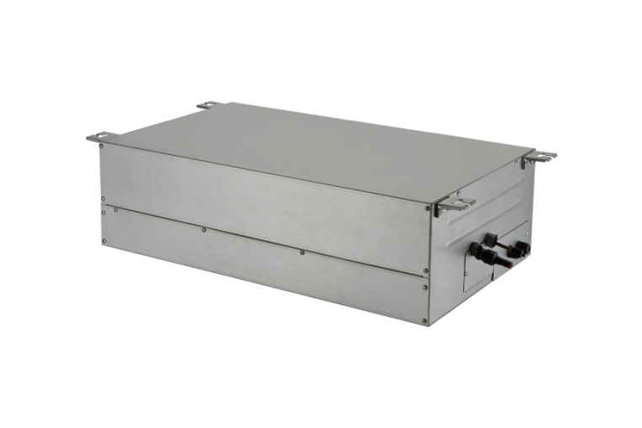
Appearance
Appearance
The heat storage module is used in the VRF system. The heat storage module can assist the unit to defrost. The heat storage module can not be used alone, but can be used with VRF units, and as an optional part for customers to choose. The heat storage module adopts heat storage defrosting technology, which is suitable for cold areas , especially coastal cities and high humidity areas in winter. The shape of the unit is as follows:

Slide 4
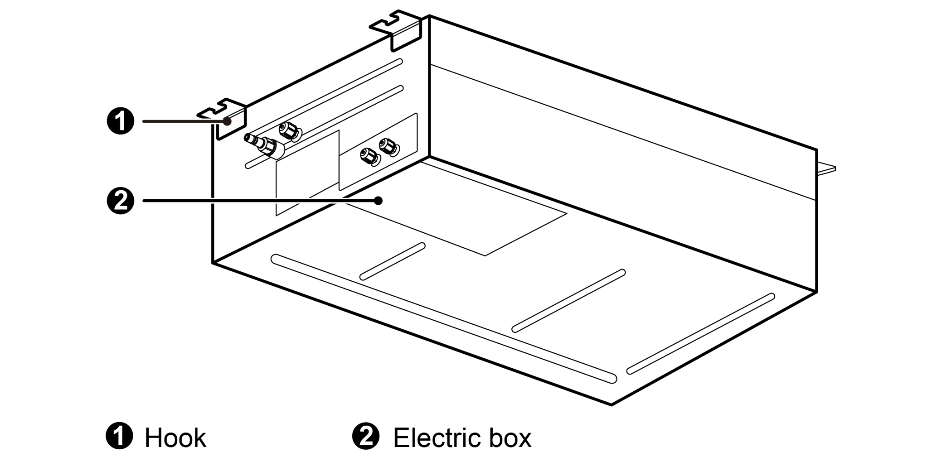
Appearance
Appearance

Slide 5
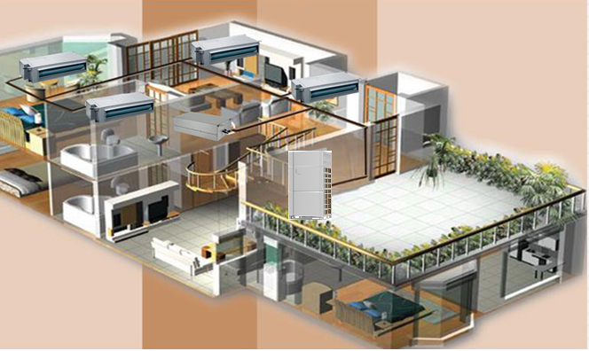
Functions
Functions
During the defrosting process of traditional air conditioning system, the heat exchanger absorbs heat from of the room, so the indoor temperature drops by 3.5 ℃, and the user's comfort experience is poor. With the VRF system with heat storage module, part of the heat will be stored in the heat storage module during the heating process. The system absorbs heat from the heat storage module during defrosting process. The temperature of the heat exchanger of the indoor unit does not drop, so the indoor temperature fluctuation is small and the user's comfort experience is good. The heat storage module is installed indoors and hoisted on the ceiling. The installation diagram is shown in the picture.

Slide 6
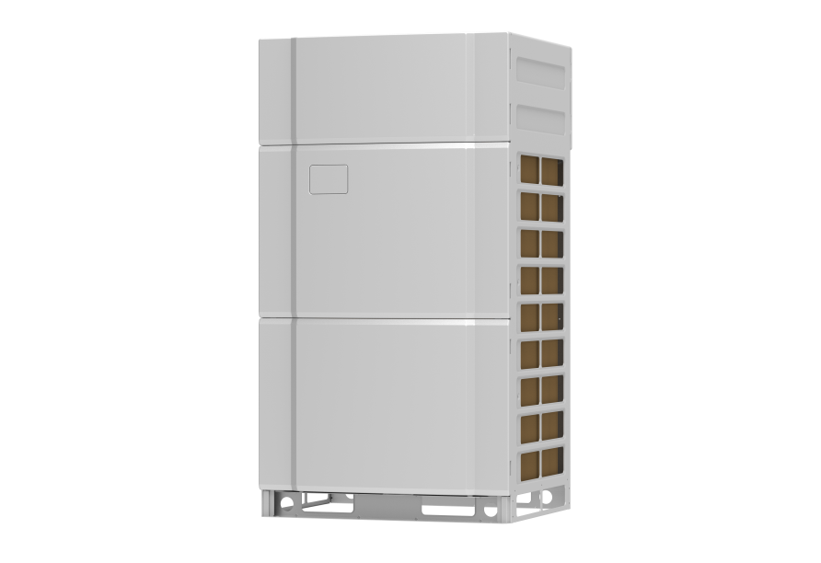
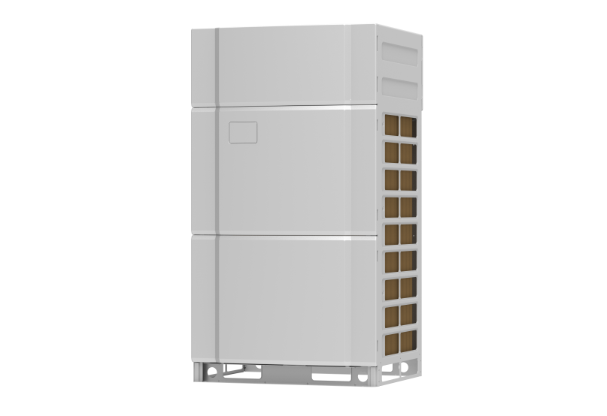
Functions
Functions
Low indoor comfort
The temperature of
the room rises slowly
Long defrosting time
High indoor comfort
The temperature of the room rises quickly
Short defrosting time

Slide 7
Disadvantages of Conventional Defrosting Methods
Functions
No. | Defect | Description
1 | Low indoor comfort | During the defrosting process, the indoor environment temperature drops by 2-7 ℃, and the thermal comfort is poor.
2 | The temperature of the indoor heat exchanger changes rapidly | During the defrosting process, the indoor heat exchanger acts as a low-level heat source, and the temperature drops sharply, reaching below - 25 ℃.
3 | The temperature of the room rises slowly | After defrosting, the internal fan needs to wait for the inner pipe temperature to rise before it can be turned on again.
4 | Long defrosting time | Moreover, the frequency rise of the compressor needs a period of time, which extends the time for heating recovery. The defrosting time is long, and in the case of severe frosting, the low-level heat source is insufficient, which further extends the defrosting time and heat recovery time.

Slide 8
Advantages of Regenerative Defrosting
Functions
No. | Advantage | Description
1 | Short defrosting time | The defrosting speed of heat storage is faster than that of conventional defrosting.
2 | High indoor comfort | After defrosting, the indoor temperature of regenerative defrosting is higher than that of conventional defrosting. 5 minutes after defrosting, the indoor temperature of regenerative defrosting is higher than that of conventional defrosting. After 50 minutes of heating operation, the indoor temperature of regenerative defrosting is higher than that of conventional defrosting.
3 | The temperature of the room rises quickly | After defrosting, the outlet air temperature of regenerative defrosting is higher than that of conventional defrosting, and the high pressure rising speed after defrosting is faster.

Slide 9
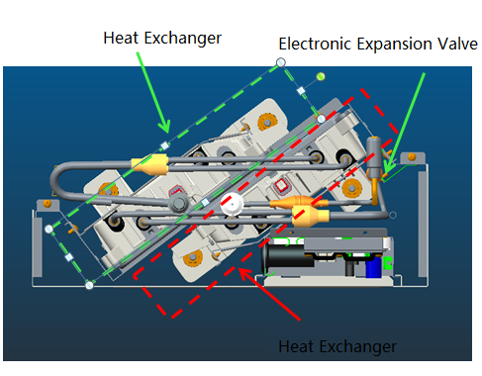
Double Layer Design
Functions
When the flow rate is small, the heat transfer rate between the refrigerant and the heat storage material becomes slow. Under the action of gravity, the refrigerant will have gas-liquid stratification, which greatly reduces the heat transfer effect. The double-layer oblique parallel structure is adopted, and the inlet and outlet pipes are on the same horizontal plane, so as to solve the problems of uneven heat transfer and serious stratification when the refrigerant flow rate is small.

Slide 10
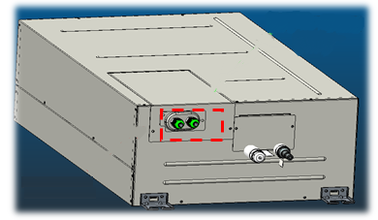
Closed Structure Design
Functions
The electrical box of heat storage module is totally airtight, and the locking joint is used at the wiring. The heat storage module is isolated from the external air to effectively prevent the internal condensation problem.

Slide 11
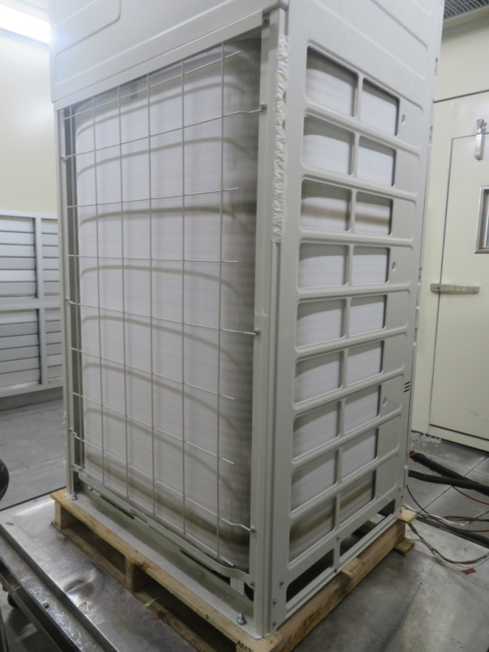
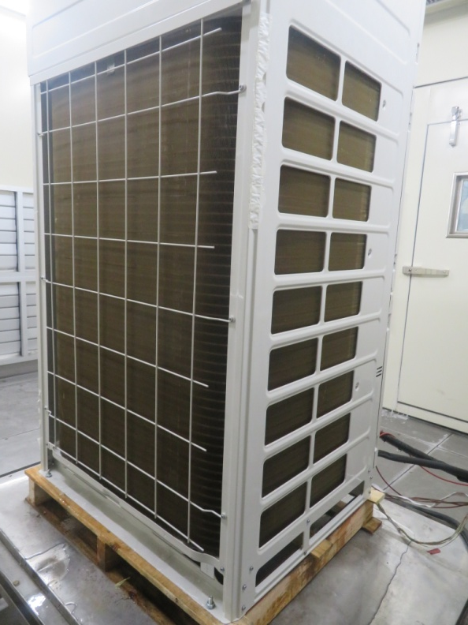
Faster Defrosting
Functions
The heat storage material can fully store heat and has good defrosting effect.
The defrosting speed of heat storage is faster than that of conventional defrosting.

Slide 12
Parameters
Functions
Model |  |  | XRZ180L/A-T
power input |  | W | 5
current input |  | A | 0.05
Maximum fuse current |  | A | 6
Power supply |  |  | 220-240V 1 phase ~50Hz 208-230V 1 phase ~60Hz
Piping interface | Liquid pipe | mm | Φ6.35
 | Gas pipe | mm | Φ12.7
Outline Dimensions (W×D×H) |  | mm | 730×450×220
Net weight |  | kg | 31.5

Slide 13
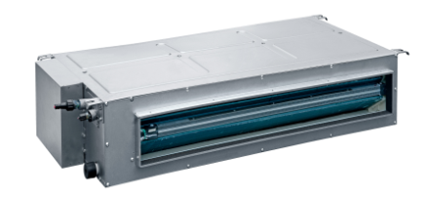
Installation
Installation

Slide 14
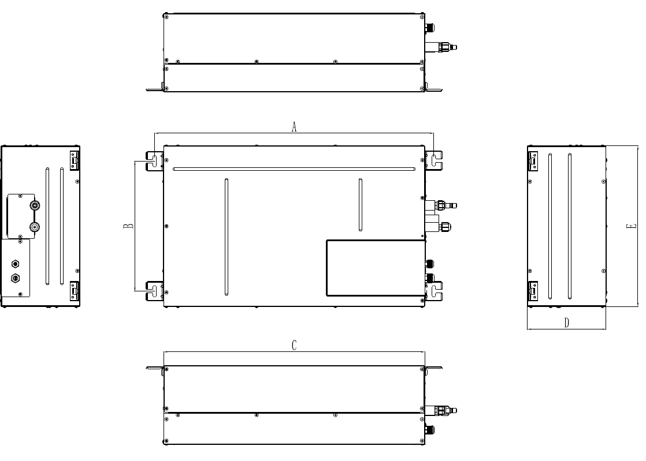
Outline Dimension
Installation
Unit: mm
Model | A | B | C | D | E
XRZ180L/A-T | 780 | 364 | 730 | 220 | 450

Slide 15
Location for Installation
Installation
The top holder must be strong enough to support unit's weight.
In order to make sure the space for maintenance, please install the heat storage module according to the dimension described below.
Keep the unit away from heating source, inflammable gas or smoke.
This is a concealed ceiling type unit.
Indoor unit, outdoor unit, power cord and electric wire should stay at least 1m from the TV set and radio. Otherwise, these electrical appliances may have image interference and noise (Even if the distance is 1m, when there is strong electric wave, noise may still occur).
The appliance shall not be installed in the laundry.
Unit: mm

Slide 16
Malfunction Codes of IDU
Installation
Error Code | Content | Error Code | Content | Error Code | Content
d4 | Inlet Pipe Temperature Sensor Error | d6 | Outlet Pipe Temperature Sensor Error | dA | Indoor Unit Hardware Address Error
C0 | Communication malfunction between IDU, ODU and IDU’s wired controller | C5 | Alarm because project code of IDU is inconsistent | — | —

Slide 17
Applicable units
Model Selection
Model series | Model number
GMV6 | GMV-224WM/H-X
 | GMV-280WM/H-X
 | GMV-335WM/H-X
 | GMV-400WM/H-X
 | GMV-450WM/H-X
 | GMV-504WM/H-X
 | GMV-560WM/H-X
 | GMV-615WM/H-X
 | GMV-224WM/G-X
 | GMV-280WM/G-X
 | GMV-335WM/G-X
 | GMV-400WM/G-X
 | GMV-450WM/G-X
 | GMV-504WM/G-X
 | GMV-560WM/G-X
 | GMV-615WM/G-X
 | GMV-680WM/G-X

Slide 18
Calculation of the Number of Heat Storage Modules
Model Selection
According to the capacity of outdoor unit, the number of heat storage modules is calculated.
After a heat storage module is full of heat, it can meet the requirements of one 18kw unit for once heat storage and defrosting.
The total capacity of heat storage modules should be within 90%~150% of that of the outdoor unit.

Slide 19
Thanks.

