Slide 1

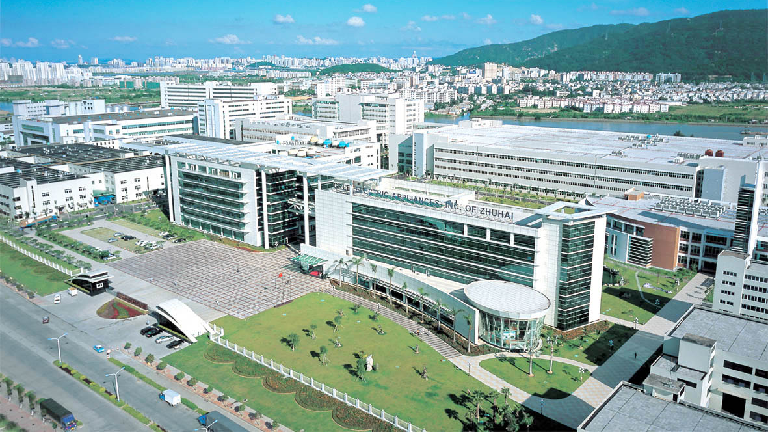
2023 GREE PROMOTION
Swimming Pool Heat Pump

Slide 2

CONTENTS
PART 01
Product Overview
PART 02
Product Highlights
PART 03
Competition Products Comparison
PART 04
Product Design & Model Selection
PART 05
Installation & Commissioning

Slide 3
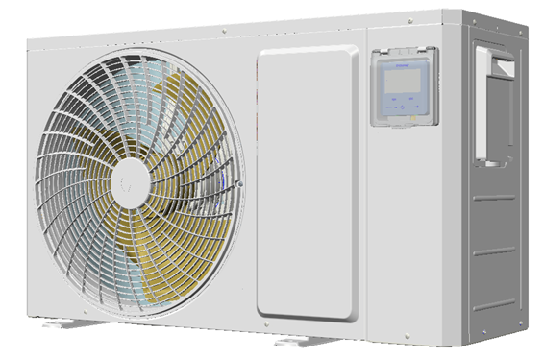
01 Product Overview
Introduction
Gree small-sized swimming pool heat pump is an integrated high efficient air-to-water heat pump unit. Besides, it is equipped with titanium heat exchanger, which has excellent anti-corrosion performance for extra long service life.
With heating capacity ranging from 2 to 18.8kW, it is suitable for a family swimming pool covering an area of 20 to 95m³. And the daily water temperature and SPA water temperature can be kept respectively between 26~30℃ and below 40℃.

Slide 4
01 Product Overview
Parameter
Model |  |  | GRS-CP11Pd/NhA-K GRS-CP11Pd/NhA-S | GRS-CP18P/NhA-K GRS-CP18P/NhA-S
Heating under High Temperature and Humidity: Ambient Temperature: 27℃/80%, Inlet Water Temperature: 26℃ | Heating Capacity | KW | 2.2~11.8 | 5.5~18.8
 | Energy Efficiency | W/W | 13.0-5.8 | 11.0~5.2
Heating under Moderate Temperature and Humidity: Ambient Temperature: 15℃/70%, Inlet Water Temperature: 26℃ | Heating Capacity | KW | 2.0-8.8 | 3.0~15.1
 | Energy Efficiency | W/W | 6.3-4.5 | 6.0~4.0
Cooling: Ambient Temperature: 35℃/-, Inlet Water Temperature: 30℃ | Cooling Capacity | KW | 4.3 | 7.8
 | Energy Efficiency | W/W | 3.2 | 4.0
Water Flow Volume |  | m3/h | 3.8 | 6.5
Operating Ambient Temperature Range |  | °C | -15~45 | -15~45
Sound Pressure Level |  | dB(A) | 52 | 55
Outlet Dimension（W*D*H） |  | mm | 980*376*554 | 1100×402×660
Weight |  | Kg | 43 | 52.5
Inlet/Outlet Water Pipe Diameter |  | mm | 50/50（PVC）
Compressor |  | / | DC inverter
Motor |  | / | DC
Refrigerant |  | / | R32
Power Supply |  | / | 1Ph/220~240V/50/60Hz

Slide 5
02 Product Highlights
R32 DC Inverter
R32 DC Inverter Technology
The adoption of DC inverter fan, compressor and electronic expansion valve contributes to a constant temperature control of the swimming pool and high-efficient operation of the system.

Slide 6
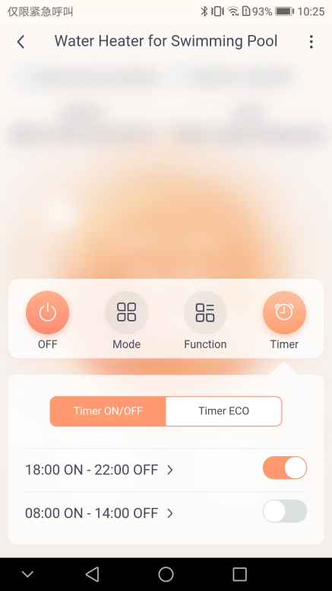
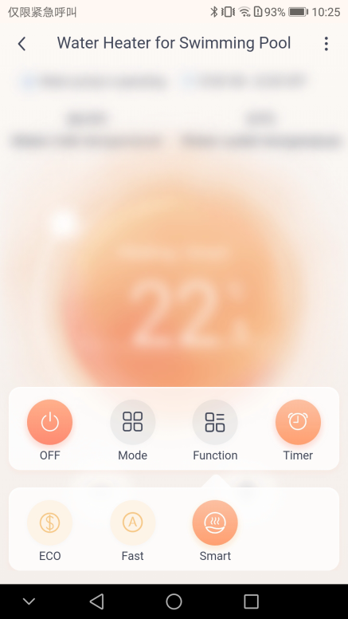
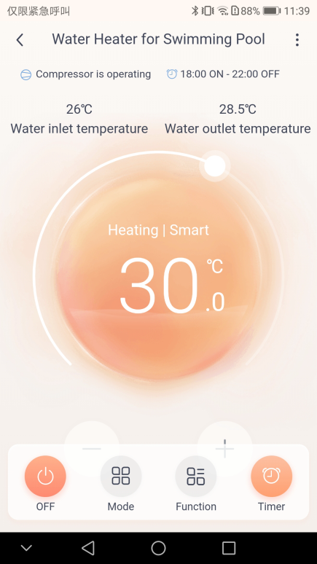
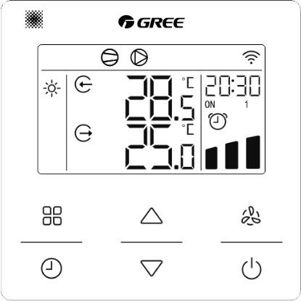
02 Product Highlights
Intelligent Control
Multi-function Intelligent Control
Controller（Display board）: ON/OFF, Cooling, Heating, AUTO, Timer, Energy saving mode, Fast heating, etc.
WiFi (on Gree+ APP): ON/OFF, Cooling, Heating, AUTO, Timer, Energy saving mode, Fast heating, etc.

Slide 7
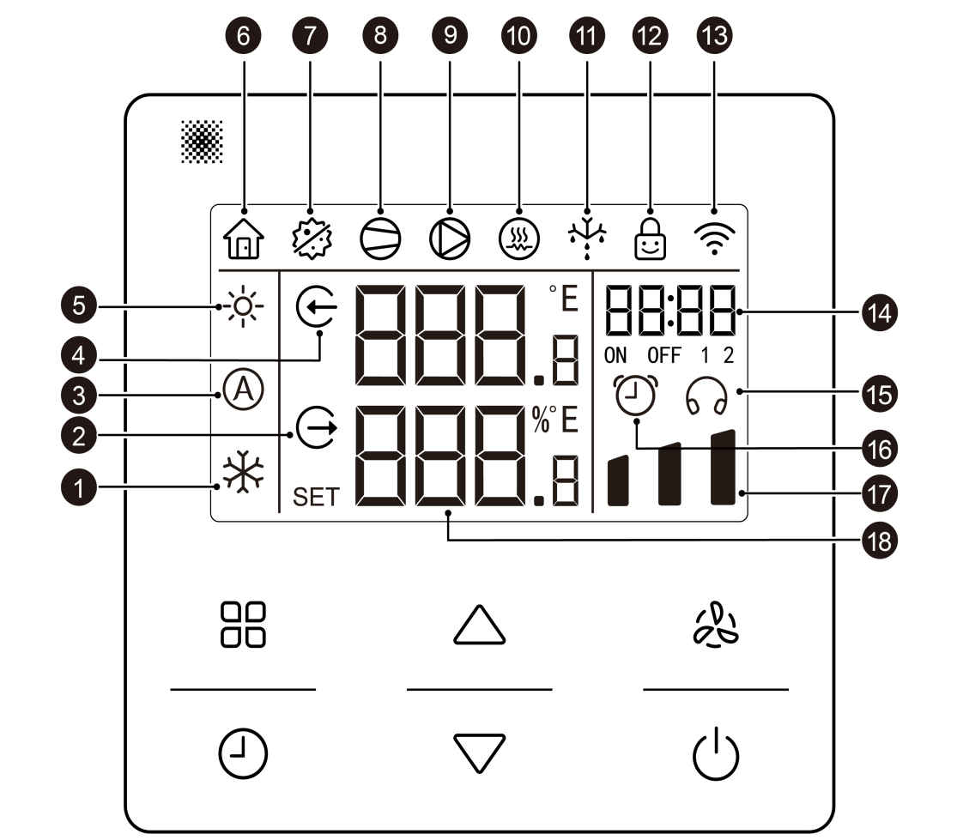
02 Product Highlights
Intelligent Control
Multi-function Intelligent Control

Slide 8
02 Product Highlights
Intelligent Control
Multi-function Intelligent Control

Slide 9
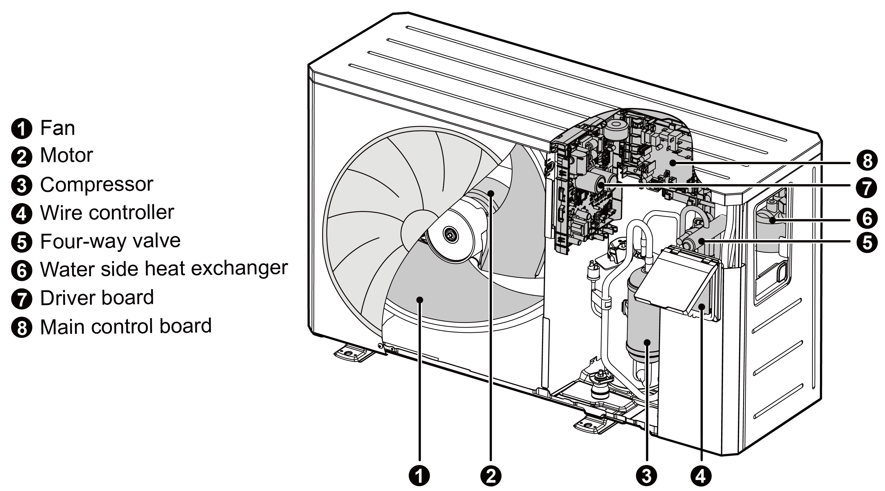
02 Product Highlights
Compact Design
Compact Design & Easy Maintenance
Thanks to the dedicated of fan heat exchange system and electronic control system, as well as the three-dimensional space layout of electronic control system, Gree swimming pool heat pump has concise appearance and compact structure which contributes to easy maintenance.

Slide 10
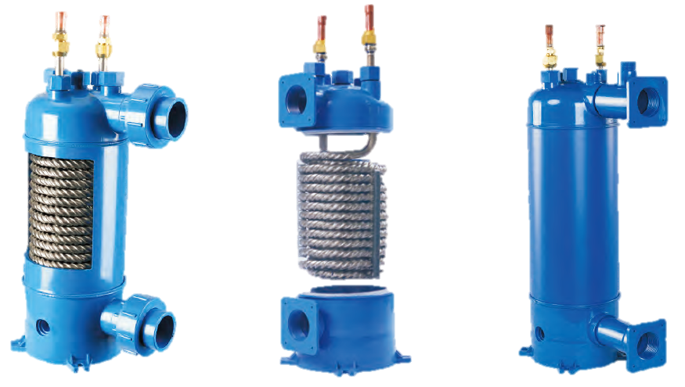
02 Product Highlights
Anti-corrosion
Anti-corrosion
Due to the adoption of seamless titanium tube for the water side, and rigid polyvinyl chloride (PVC) material by the outer shell, Gree swimming pool heat pump can achieve high acid resistance, great alkali resistance, excellent corrosion resistance, and with low fluid resistance, which makes it more suitable for the heat exchange of frequently-disinfected swimming pool water.
Titanium Tube Heat Exchanger

Slide 11
03 Competition Products Comparison
Products Comparison
Brand | A (11kw) | Gree (11kw)
Heating Capacity under High Temperature (kw) | 1.97~11.66 | 2.20~11.8
Outline Dimension (W*D*H)(mm) | 1000*418*605 | 980*376*554
Net Weight/Gross Weight (kg) | 51/62 | 43/52
Energy Efficiency under High Temperature | 12.57-5.84 | 13.0-5.8
Setting Water Temperature (℃) | Cooling: 8~35 Heating: 15~35 | Cooling: 10~40 Heating: 15~40
Operating Ambient Temperature Range (℃) | -5~43 | -15~45
Function | Heating, Cooling, AUTO, timing, Quite mode, WiFi (isolated module) | Heating, Cooling, AUTO, Timing, Energy saving mode, WiFi (integrated in the controller)

Slide 12
03 Competition Products Comparison
Products Comparison
Brand | A (18kw) | Gree (18kw)
Heating Capacity under High Temperature (kw) | 3.5~18.7 | 5.5~18.8
Outline Dimension (W*D*H)(mm) | 1160x490x862 | 1100×402×660
Net Weight/Gross Weight (kg) | 74/- | 52.5/62.5
Energy Efficiency under High Temperature | 10.94-5.12 | 11.0~5.2
Setting Water Temperature (℃) | Cooling: 8~35 Heating: 15~35 | Cooling: 10~40 Heating: 15~40
Operating Ambient Temperature Range (℃) | -5~43 | -15~45
Function | Heating, Cooling, Auto, timer, Silence mode, WiFi (isolated module) | Heating, Cooling, Auto, Timer, Energy saving mode, WiFi (integrated in the controller)

Slide 13
04 Product Selection
Model Selection
Swimming pool volume and operating ambient temperature should be taken into account for the product selection.
 | Swimming Pool Volume (m³)
Model | Ambient Temperature ≥25℃ | Ambient Temperature 15~24℃ | Ambient Temperature -15~15℃
GRS-CP11Pd/NhA-S | 40~75 | 15~40 | ＜15
GRS-CP18Pd/NhA-S | 55~95 | 20~55 | ＜20
Note：
1. The recommended maximum pool volume is based on the ideal heating condition that the pool is well shaded; the filtration system runs for 15h per day, water temperature is maintained at 26℃,and ambient temperature ≥28℃.
2. The model selection should be comprehensively evaluated according to water refill temperature, wind speed on the surface of the swimming pool, ambient temperature, etc. If the ambient temperature is below 15℃, it is suggested to add the secondary heat source for auxiliary heating to improve the comfort.
Notes:
（依据CJJ+122-2017《+游泳池给水排水工程技术规程》，默认温度28℃，按照每日运行时间20h计算）

Slide 14
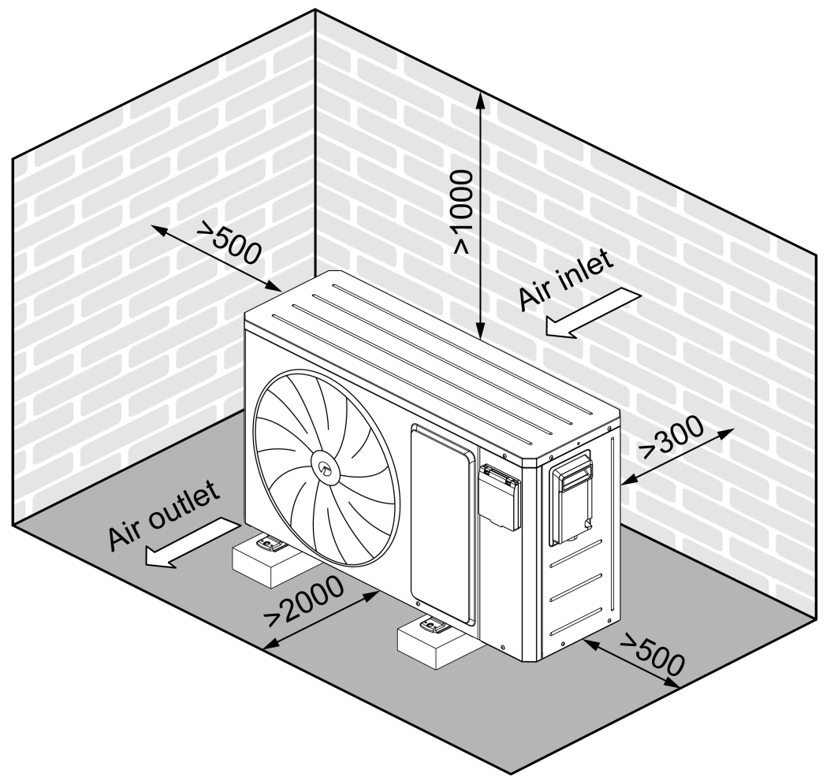
05 Installation & Commissioning
Installation Precautions
Installation Precautions:
Installation of the unit should comply with local safety regulations;
Installation and maintenance of the unit must be performed by professional personnel;
The unit needs a specialized circuit power supply and all-pole disconnect switch;
Please keep the unit away from combustible source;
Please provid the unit with reliable ground connection;
The unit should be installed horizontally;
Please choose a suitable installation place where there is no possibility that the unit will be buried by snow , or damaged by garbage and oil mist ;
Please Keep the air outlet side of the unit away from strong wind.
unit：mm

Slide 15
05 Installation & Commissioning
Water Quality
Water Quality Requirements
Recommended Value | Fiberglass Swimming Pool | Fiberglass SPA | Other Swimming Pool and SPA
Water Temperature (℃) | 20~31 | 32~40 | 20~40
PH | 7.3~7.4 | 7.3~7.4 | 7.6~7.8
Total Alkalinity (PPM) | 120-150 | 120-150 | 80-120
Calcium Hardness (PPM) | 200-300 | 150-200 | 200-400
Salinity (PPM) | ≤4500 | ≤4500 | ≤4500
Free Chlorine (PPM)＜5 | 2-3 | 2-3 | 2-3
Total Dissolved Solids (PPM) | ≤3000 | ≤3000 | ≤3000
* Notes: The total dissolved solids in the salt pond can be up to 6000PPM.
Notes:
水质数据来源于北美产品资料

Slide 16
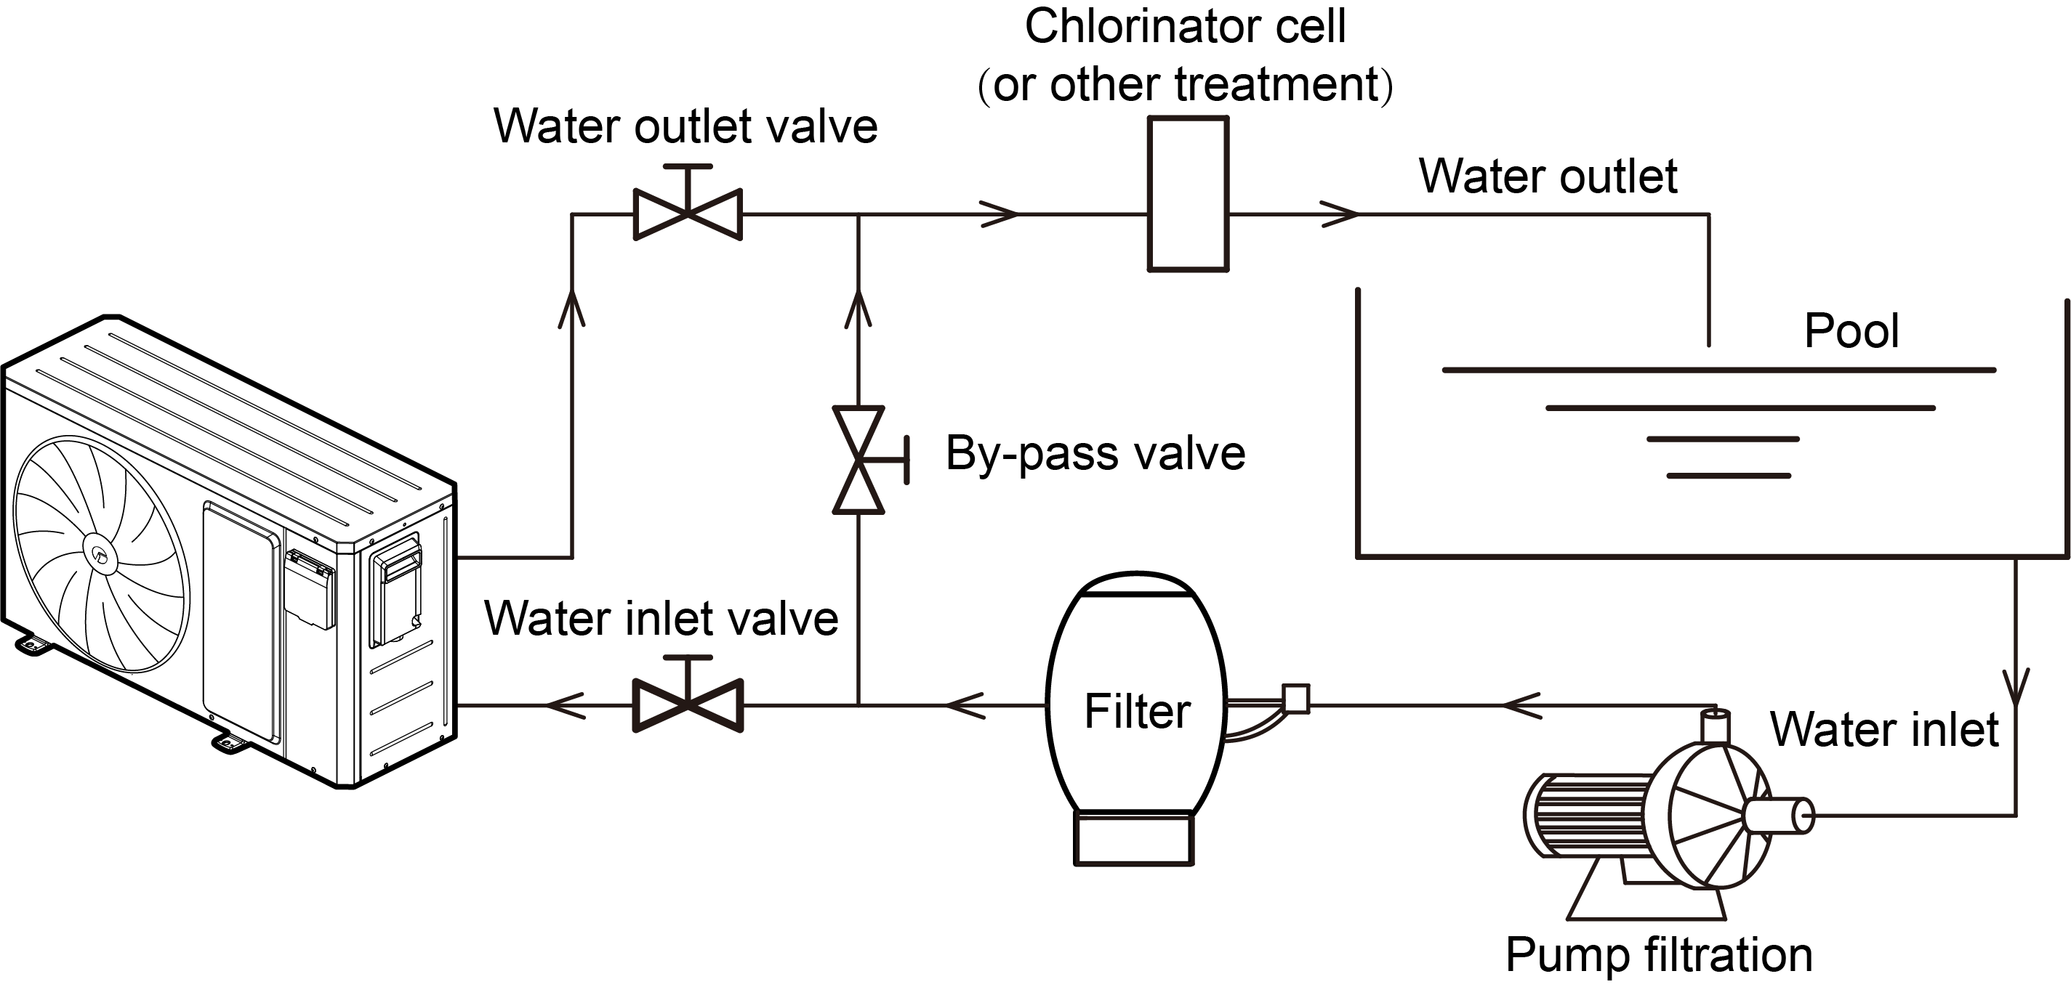
05 Installation & Commissioning
Water Side
Water Side Installation

Slide 17
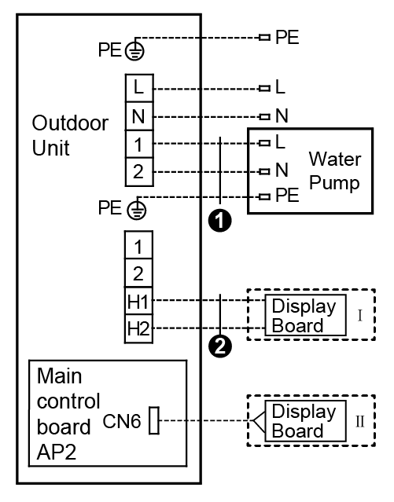
05 Installation & Commissioning
Electrical Circuit
Electrical Circuit Installation
GRS-CP11Pd/NhA-S（K） GRS-CP18Pd/NhA-S（K）
① Water pump power cord: 3×1.0 mm² ② Display board cord: 2×0.75 mm²
Note:
Connect according to either method I or method II

Slide 18
05 Installation Commissioning
Debugging
Commissioning Procedures:
1. Please make sure that the unit is correctly installed and connected to the right power source.
2. Please connect the water pump before power on the unit . After that, please finish water flow regulation and water flow check in 8 minutes, and make sure that the water flow of the heat pump unit can be 60~120% of the nominal value.
On the contrary, if the water pump is disconnected to the heat pump unit, please turn on the pump first and ensure that the water flow of the heat pump unit can be 60~120% of the nominal value. After that, the heat pump unit can be powered on and turned on once the normal water connection is available.
3. Finally, please adjust corresponding mode and other parameters according to the operation instruction of the unit.

Slide 19
Thanks.

